Slide 1


Ultra-Low-Latency Graph Neural Networks: Applications and Implementations
Workshop on Graph Techniques for Adversarial Activity Analytics (GTA³ 2023)
Cong (Callie) Hao
Assistant Professor
Georgia Institute of Technology
School of Electrical and Computer Engineering
Sharc-lab @ Georgia Tech https://sharclab.ece.gatech.edu/

Slide 2



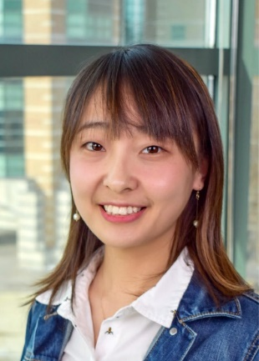

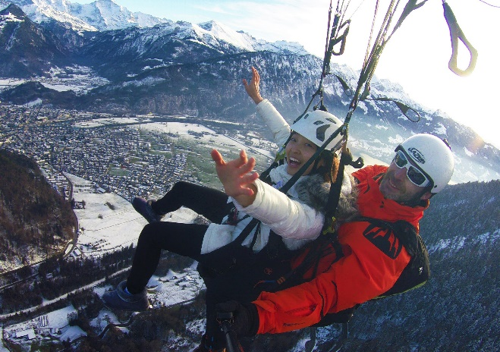
Self-Introduction
@ Japan, Fujisan
Cong (Callie) Hao
  Assistant Professor at Georgia Tech ECE
  Faculty Fellow at GT (2021~2022)
  Postdoc at UIUC (2018~2020)
  Ph.D. in Japan, Waseda University (2017)
@ Illinois Marathon
  Email: callie.hao@ece.gatech.edu
  Homepage: http://callie.ece.gatech.edu
@ Switzerland, Jungfrau

Slide 3

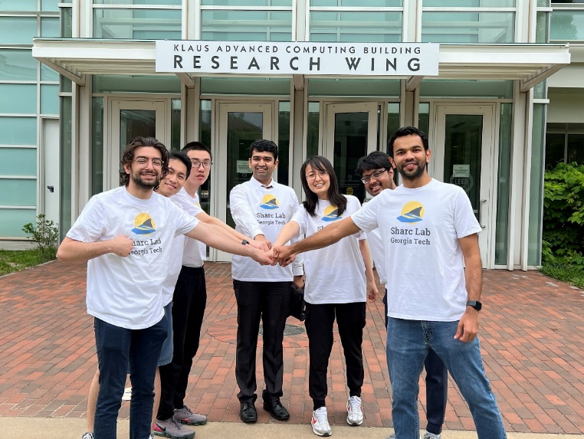
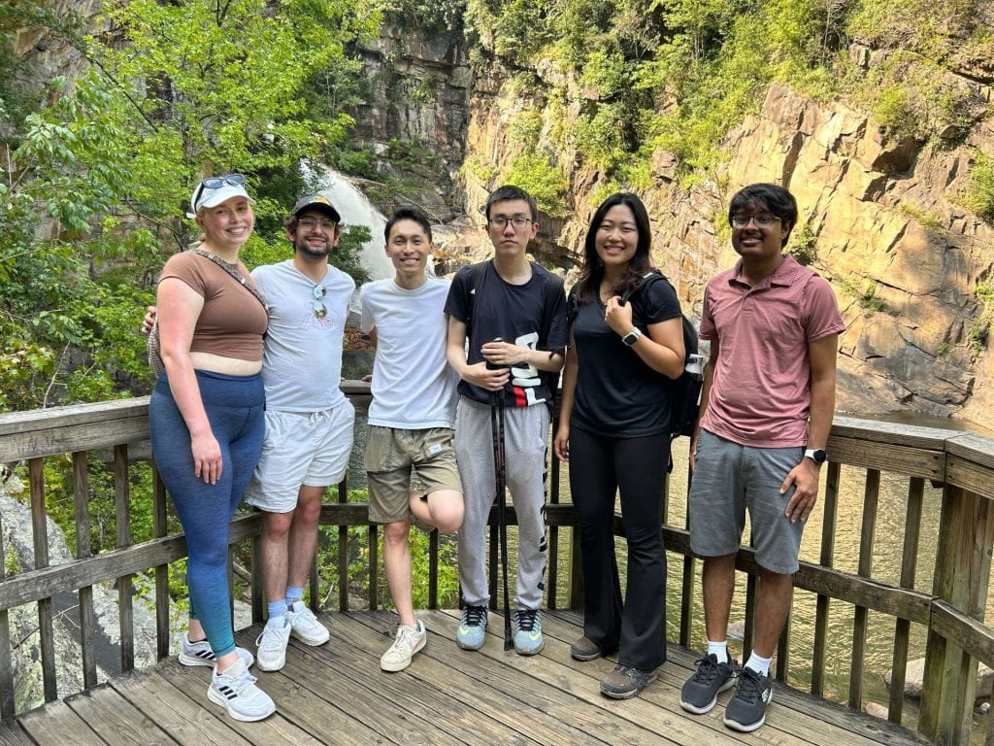
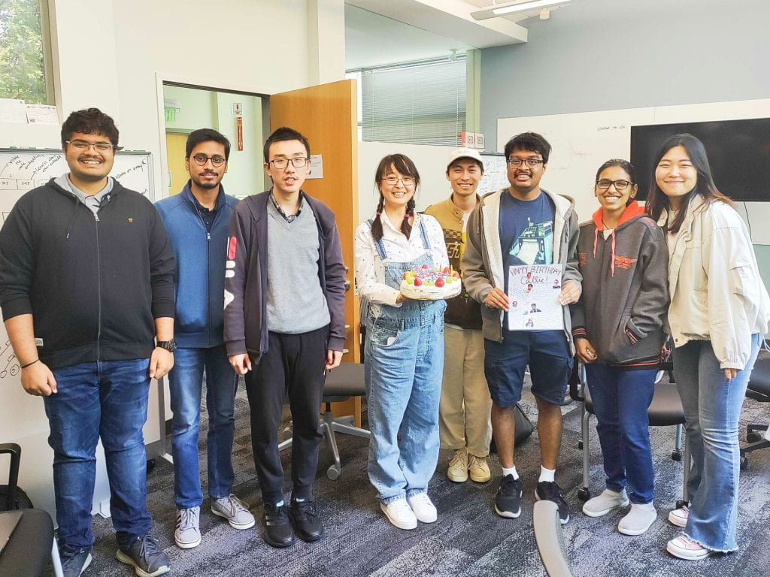
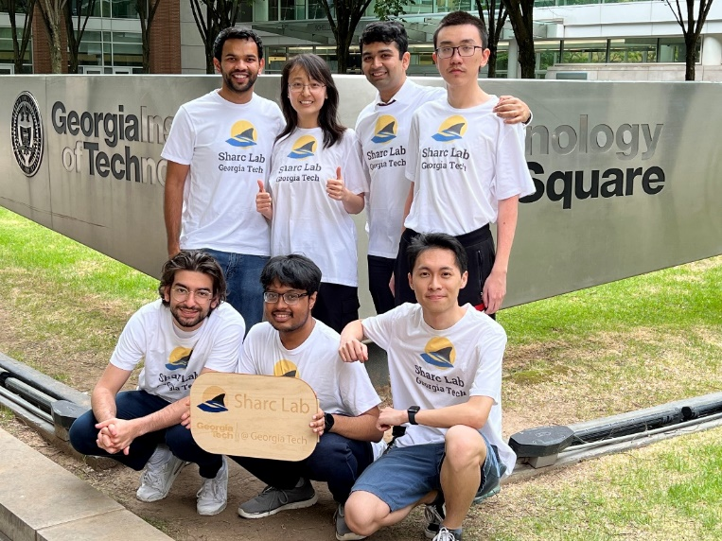
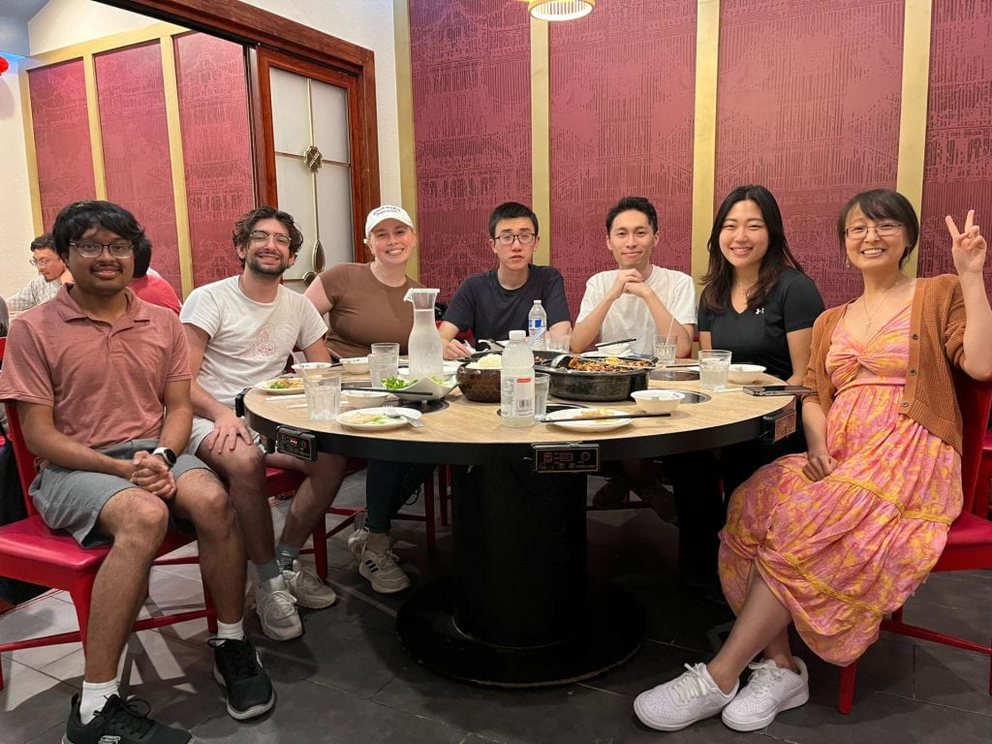
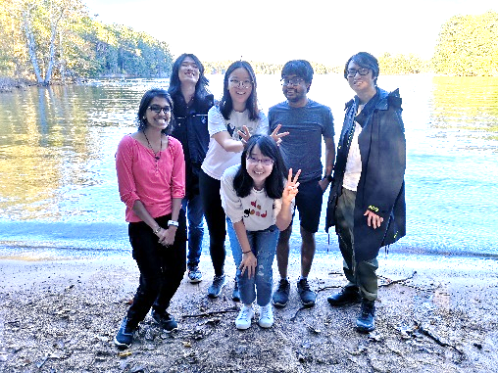
Sharc Lab
Software/Hardware Co-Design for Intelligence and Efficiency

Slide 4




What I Learned from My Colleague Doing ML
Algorithm Accuracy
Algorithm Robustness and Trustworthy
Algorithm Execution

Slide 5

Ultra-Low-Latency GNN Inference
Fraud and spam detection
~ milliseconds to low seconds
LiDAR and Point Cloud Data for Autonomous Driving
~ tens to hundreds of milliseconds
Real-Time Requirement
High Energy Physics
~ microseconds, even nanoseconds
And many more …

Slide 6
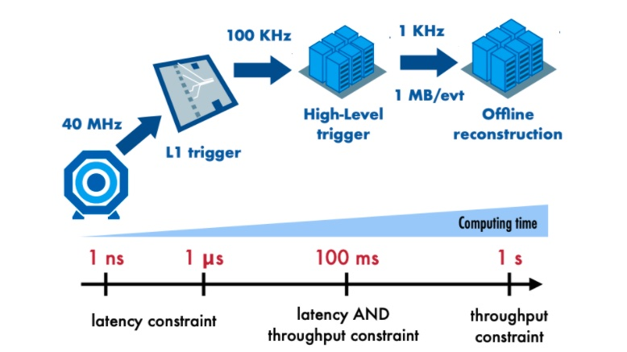
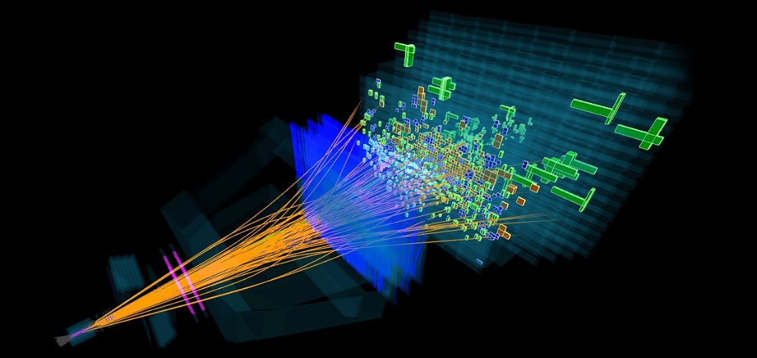
High Energy Physics Experiment Pipeline
[image source] https://www.quantamagazine.org/growing-anomalies-at-the-large-hadron-collider-hint-at-new-particles-20200526/

Slide 7
High Energy Physics Experiment Pipeline
In the particle detectors at the CERN Large Hadron Collider, O(10) millions of proton-proton collisions are produced every second ^{[1]}
The resulting data throughput is O(10) TB/s – too large to be recorded ^{[1]}
[image source] https://www.quantamagazine.org/growing-anomalies-at-the-large-hadron-collider-hint-at-new-particles-20200526/
[1] Govorkova, Ekaterina, et al. "LHC physics dataset for unsupervised New Physics detection at 40 MHz." Scientific Data 9.1 (2022): 118.

Slide 8
High Energy Physics Experiment Pipeline
The Level-1 trigger (L1T) rejects more than 98% of the events, reducing the incoming data stream to 100k events/s
Time interval between two events: 25 ns
The entire pipeline of L1T algorithms: within O(1) microseconds
[1] Govorkova, Ekaterina, et al. "LHC physics dataset for unsupervised New Physics detection at 40 MHz." Scientific Data 9.1 (2022): 118.

Slide 9
High Energy Physics Experiment Pipeline
The high-level trigger runs on commercial CPUs
Executes complex selections algorithms within O(100) ms
[1] Govorkova, Ekaterina, et al. "LHC physics dataset for unsupervised New Physics detection at 40 MHz." Scientific Data 9.1 (2022): 118.

Slide 10

High Energy Physics Experiment Pipeline
Our focus
[image source] https://a3d3.ai/activities/high-energy-physics/

Slide 11
Why Challenging?
Our focus
Challenging?
[image source] https://a3d3.ai/activities/high-energy-physics/

Slide 12
Why Challenging?
Algorithms (GNNs) are complicated
GPUs and CPUs are too slow
Designing optimal architecture is non-trivial
Manual mapping is time-consuming

Slide 13
Why Challenging? – Reason 1
Algorithms (GNNs) are complicated
GPUs and CPUs are too slow
Designing optimal architecture is non-trivial
Manual mapping is time-consuming

Slide 14
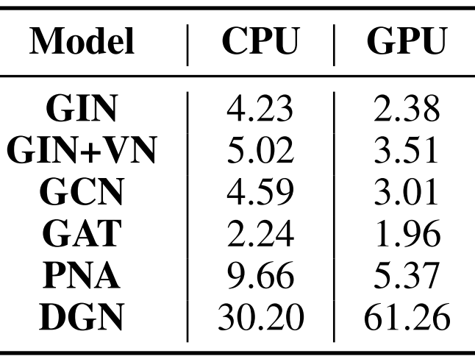
Why Challenging? – Reason 2
Algorithms (GNNs) are complicated
GPUs and CPUs are too slow
Designing optimal architecture is non-trivial
CPU/GPU latency is at microsecond level
Goal is 1 us (or less)

Slide 15
Why Challenging? – Reason 3
Many variations of GNNs and a lot of them CANNOT be simply formulated as (sparse) matrix multiplication
  If there are edge embeddings
  If anisotropic message passing
  If non-trivial aggregation function (other than sum)
  …
Designing optimal architecture is non-trivial
Manual mapping is time-consuming

Slide 16




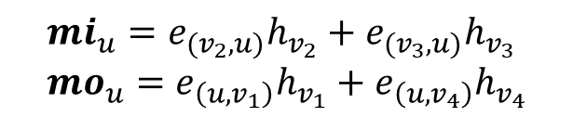




Why Challenging? – Reason 3
A GNN model used for particle tracking
$$e_{(u,v)}$$
u
v
$$h_{u}$$
$$h_{v}$$
$$h_{v}^{0}=MLP_{input}\left(x_{v}\right), ∀v∈V \\ for k=1,…,K: \\ e_{(u,v)}^{k}=MLP_{edge}\left(CONCAT\left(h_{u}^{(k−1)},h_{v}^{(k−1)}\right)\right),∀\left(u,v\right)∈E \\ mi_{v}^{k}=\sum_{u∈in(v)}{\left(e_{(u,v)}^{k}⋅h_{u}^{(k−1)}\right),∀v∈V} \\ mo_{v}^{k}=\sum_{u∈out(v)}{\left(e_{(u,v)}^{k}⋅h_{u}^{(k−1)}\right),∀v∈V} \\ h_{v}^{k}=h_{v}^{(k−1)}+MLP_{node}\left(CONCAT\left(mi_{v}^{k},mo_{v}^{k},h_{v}^{k−1}\right)\right),∀v∈V \\ e_{u,v}^{K}=MLP_{edge}\left(CONCAT\left(h_{u}^{K},h_{v}^{K}\right)\right),∀\left(u,v\right)∈E$$
v₁
$$e_{(v_{2},u)}$$
$$e_{(u,v_{1})}$$
v₂
u
$$e_{(u,v_{4})}$$
v₄
v₃
$$e_{(v_{3},u)}$$
$${mi_{u}=e}_{(v_{2},u)}h_{v_{2}}+e_{{(v}_{3},u)}h_{v_{3}} \\ mo_{u}=e_{\left(u,v_{1}\right)}h_{v_{1}}+e_{\left(u,v_{4}\right)}h_{v_{4}}$$

Slide 17
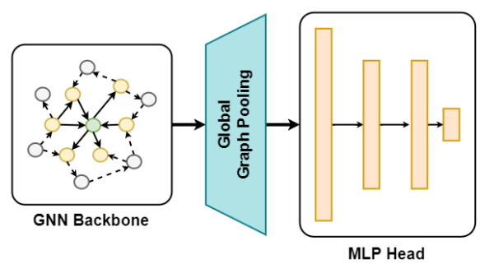





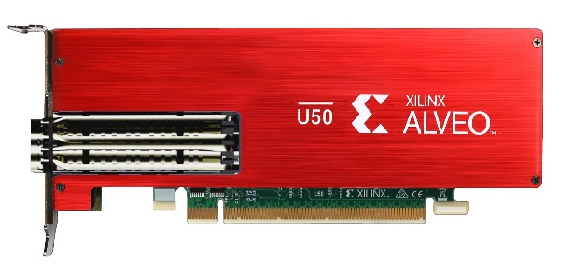
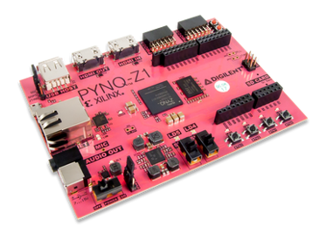
Why Challenging? – Reason 4
  FPGA
High-Level
Synthesis
Logic Synthesis
Physical Synthesis
  C/C++
  RTL (Verilog)
  Netlist
  Bitstream
Manual mapping is time-consuming

Slide 18




What Can We Do?
Algorithms (GNNs) are complicated
GPUs and CPUs are too slow
  Simplify the algorithm design
  Specialized computing hardware: Field Programmable Gate Array (FPGA)
Designing optimal architecture is non-trivial
Manual mapping is time-consuming
  A general architecture for GNN beyond (sparse) matrix multiplication
  Design automation from algorithm to hardware

Slide 19
Simplifying Algorithm Design
Straightforward: reduce the number of layers, dimensions, etc.
  For the particle tracking GNN model, we reduced:
    The number of GNN layers from 4 to 1
    The node and edge embedding MLP dimension from 64 to 8
    The accuracy almost did not change
  In another experiment, we merged two GNNs into one:
    TrackGNN + TriggerGNN → one GNN
    The accuracy only slightly dropped
Aggressive quantization: still needed
  Current data precision: 16-bit if no accuracy loss
  8-bit? 4-bit? Binary?
  Not only model weights but also embeddings

Slide 20
Specialized computing hardware: FPGA
FPGA: a flexible hardware that can create customized circuit and computation logic
  Preferred for L1 trigger due to its low latency (compared with CPU and GPU)
FPGA

Slide 21
A General Architecture for GNNs on FPGA
Why general architecture?
  GNN models keep evolving – we don’t want to re-design our hardware every time when there is a new model
How to design a general architecture?
  Especially that GNNs are NOT all about matrix multiplications
  Any similarities across different GNNs?
Explicit message passing mechanism
  As long as our hardware architecture can flexibly support message passing, almost all GNNs can be supported (with minor changes)

Slide 22
Existing Work
Most focus on Graph Convolution Network (GCN): A limited type
Heavy pre-processing: Not suitable for real-time
Most on ASIC via simulation: not end-to-end, far from practical

Slide 23
Existing Work vs. Ours
Most focus on Graph Convolution Network (GCN): A limited type
Support a wide range of GNNs: Generic
Heavy pre-processing: Not suitable for real-time
No pre-processing: Real-time oriented
FlowGNN: a dataflow-based general GNN architecture (HPCA’23)
High-Level Synthesis (HLS) based
Open sourced: https://github.com/sharc-lab/flowgnn
Most on ASIC via simulation: not end-to-end, far from practical
Evaluated end-to-end on FPGA

Slide 24
Key Technologies to Improve Performance
What optimizations that GPU cannot but FPGA can?
  NT: node transformation; MP: message passing (gather and scatter)
GPU
FPGA
NT
Idle resource
NT
Each region’s logic is customized differently according to a specific function
Time multiplex for the same hardware resources
NT-to-MP Adapter
(edge multicasting)
MP
MP
Idle resource

Slide 25

Key Technologies to Improve Performance
What optimizations that GPU cannot but FPGA can?
  NT: node transformation; MP: message passing (gather and scatter)
GPU
FPGA
NT
Idle resource
NT
MP
MP
Idle resource
Possible idleness and inefficiency
time
time
NT
NT and MP are computed sequentially
MP
time

Slide 26
Key Technologies to Improve Performance
What optimizations that GPU cannot but FPGA can?
  NT: node transformation; MP: message passing (gather and scatter)
FPGA
NT
Idle resource
Secret
Fully utilize all resources
Each submodule specially customized
MP
Idle resource
time
NT
MP
time

Slide 27
Key Technologies to Improve Performance
Overlapping NT and MP on FPGA: ready-node queue
  Ready for message passing
NT
Idle resource
MP
Idle resource
time
NT
Drawback: no node/edge level parallelism: one by one is still too slow!
ready-node queue
MP
time

Slide 28
Key Technologies to Improve Performance
Overlapping NT and MP for multiple nodes/edges: multi-casting
  To avoid memory bank conflict – a common problem when processing graphs
NT
NT1
NT2
ready-node queue
ready-node queue + multi-casting
MP
time
MP1
MP2
MP3
MP4
time

Slide 29
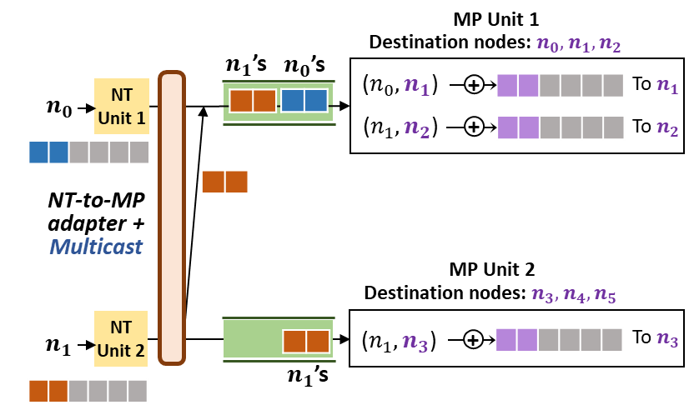
Key Technologies to Improve Performance
Overlapping NT and MP for multiple nodes/edges: multi-casting
  To avoid memory bank conflict – a common problem when processing graphs
NT1
NT2
ready-node queue + multi-casting
MP1
MP2
MP3
MP4
time

Slide 30
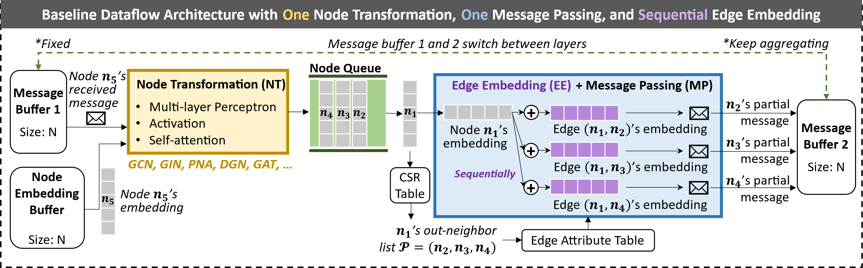
FlowGNN Architecture

Slide 31
Experiment Setup
Tested on seven GNN models with edge embeddings
  GCN, GIN, GIN + virtual node, GAT, PNA, DGN, TrackGNN
  TrackGNN is a specialized GNN in high energy physics
Evaluated end-to-end on-board on Xilinx Alveo U50 @ 300 MHz
  CPU baseline: Intel Xeon Gold 6226R (batch size 1)
  GPU baseline: NVIDIA RTX A6000 (batch size 1 ~ 1024)
Evaluated on eight datasets, including two from high-energy physics
  Many small graphs are sent to the FPGA one by one – batch size 1
  Not a single large graph

Slide 32
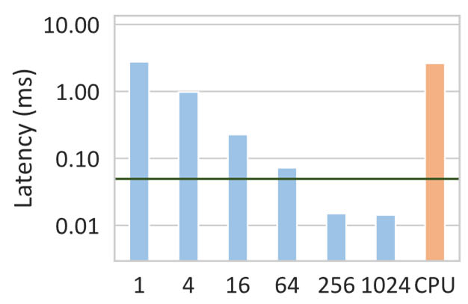
Evaluation – End-to-end Latency
(
GIN
a
)
M
o
l
H
I
V
Average Latency (ms/graph)
FlowGNN: 0.05ms
On GPU: batch size from 1 to 1024
Notes:
Here we show comparisons on our molecular datasets against GPU and CPU baselines. We see that FlowGNN achieves 50 to 250 times speedup over CPU and 50 to 480 times speedup over GPU at batch size one.
Although batch size 1 is the only fair comparison in a real-time setting, we also compare against GPU at higher batch sizes, and we still see speedup on all models and both datasets up to batch size 64.
The FlowGNN GAT and DGN models even beat GPU at batch size 1024.

Slide 33
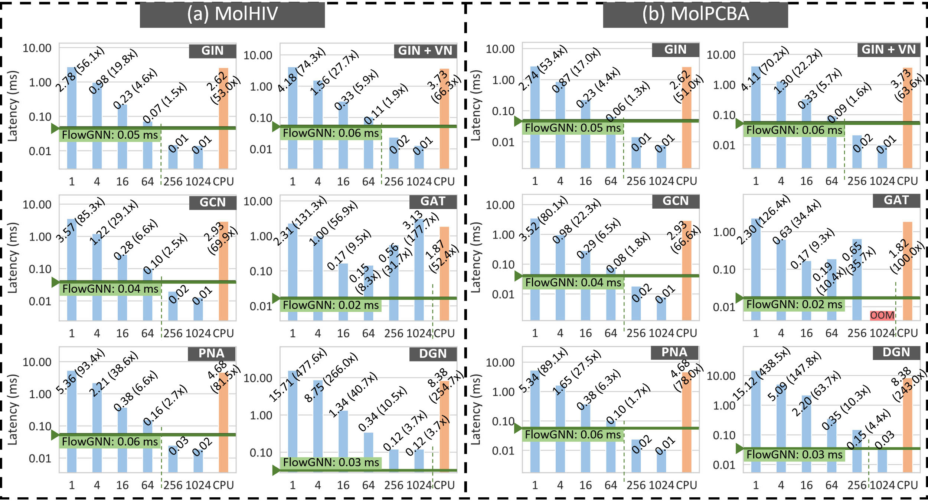
Evaluation – End-to-end Latency
Notes:
Here we show comparisons on our molecular datasets against GPU and CPU baselines. We see that FlowGNN achieves 50 to 250 times speedup over CPU and 50 to 480 times speedup over GPU at batch size one.
Although batch size 1 is the only fair comparison in a real-time setting, we also compare against GPU at higher batch sizes, and we still see speedup on all models and both datasets up to batch size 64.
The FlowGNN GAT and DGN models even beat GPU at batch size 1024.

Slide 34
Evaluation – End-to-end Latency
Observations:
FlowGNN is 50~250x over CPU, 50~480x over GPU at bs=1
For all models, FlowGNN outperform GPU for bs<=64
For GAT and DGN, FlowGNN beats GPU at bs=1024
Notes:
Here we show comparisons on our molecular datasets against GPU and CPU baselines. We see that FlowGNN achieves 50 to 250 times speedup over CPU and 50 to 480 times speedup over GPU at batch size one.
Although batch size 1 is the only fair comparison in a real-time setting, we also compare against GPU at higher batch sizes, and we still see speedup on all models and both datasets up to batch size 64.
The FlowGNN GAT and DGN models even beat GPU at batch size 1024.

Slide 35
Evaluation – TrackGNN
Real GNN model used in High Energy Physics, TrackGNN
  First goal is within 10 us (will be more aggressive in reality – 10x to 15x faster)
    GPU is tens of microseconds
Version one
  5 layers, each layer has two sets of MLP, each MLP is 4-layer, 64 dimension
  FPGA latency is 130 us
Version two
  1 layer, each layer has two sets of MLP, each MLP is 4-layer, 8 dimension
  FPGA latency is 8.82 us (almost there)
Notes:
Here we show comparisons on our molecular datasets against GPU and CPU baselines. We see that FlowGNN achieves 50 to 250 times speedup over CPU and 50 to 480 times speedup over GPU at batch size one.
Although batch size 1 is the only fair comparison in a real-time setting, we also compare against GPU at higher batch sizes, and we still see speedup on all models and both datasets up to batch size 64.
The FlowGNN GAT and DGN models even beat GPU at batch size 1024.

Slide 36


FlowGNN Source Code
Open-source and fully evaluated on-board
  Functionality and performance guaranteed!
https://github.com/sharc-lab/FlowGNN

Slide 37
What Can We Do?
Algorithms (GNNs) are complicated
GPUs and CPUs are too slow
  Simplify the algorithm design
  Specialized computing hardware: Field Programmable Gate Array (FPGA)
Designing optimal architecture is non-trivial
Manual mapping is time-consuming
  A general architecture for GNN beyond (sparse) matrix multiplication
  Design automation from algorithm to hardware

Slide 38

Design automation from algorithm to hardware
Manual hardware design and mapping is very time-consuming
  Writing Verilog is a nightmare for large designs
  Even with the help of High-Level Synthesis – an advanced tool to design hardware in C++ instead of Verilog
But we like PyTorch…
GNNBuilder to automatically convert from PyTorch to FPGA design (in Verilog)
  FPL’23 (International Conference on Field-Programmable Logic and Applications)
  Won the Community Award – to recognize the contribution to open-source hardware and tool

Slide 39
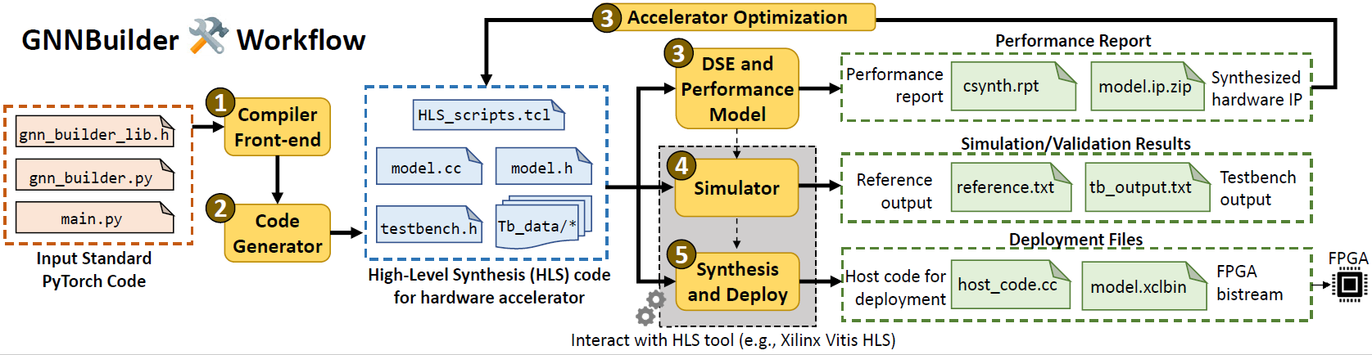
GNN Builder Workflow
A fully-automated, end-to-end GNN accelerator generation on FPGA
  Standard PyTorch input, FPGA bitstream + hostcode output

Slide 40
GNN Builder Features
Generic: Wide range of GNN model types (follows FlowGNN principle)
Flexible: Highly customizable GNN models
Standard and Extensible API: Standard PyTorch as inputs
Completeness: Multi-level tasks (node, link, graph) with end-to-end workflow
DSE: Accelerator design space exploration (DSE) and optimization
Deployment: End-to-end with host code
Performance: Better than CPU and GPU

Slide 41
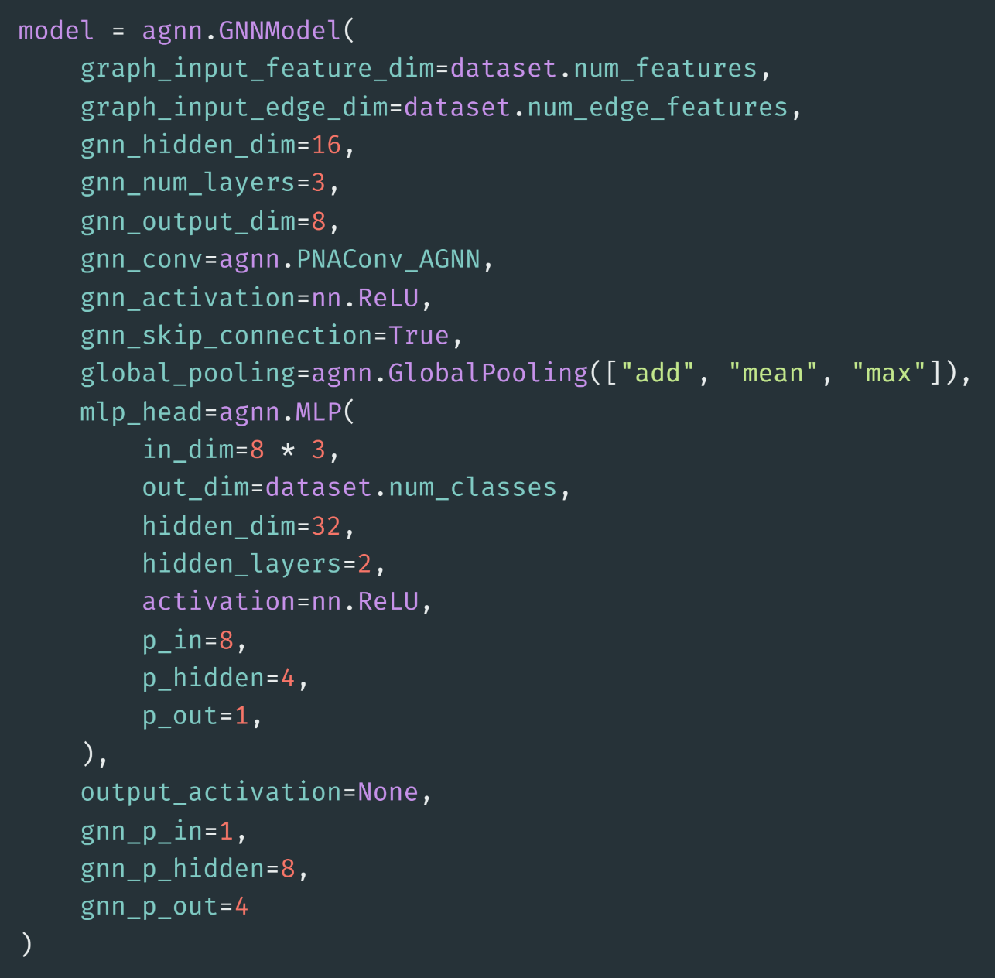
Standard PyTorch API
Create a fully parameterized GNN model using native PyTorch Geometric layers
Behaves as a standard nn.Module
  Zero gap from training to deployment

Slide 42
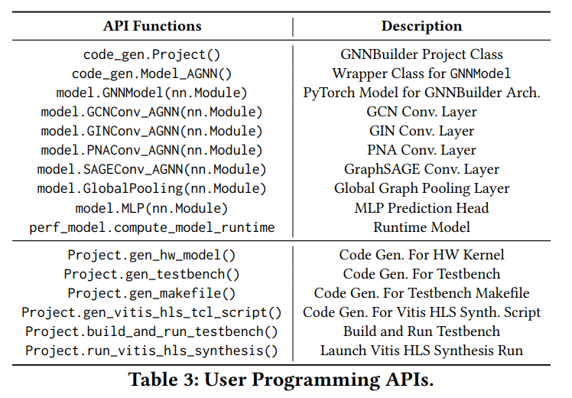
Standard PyTorch API (cont.)
(SW)
Model and layer definition
(HW)
HLS code generation and deployment on FPGA

Slide 43
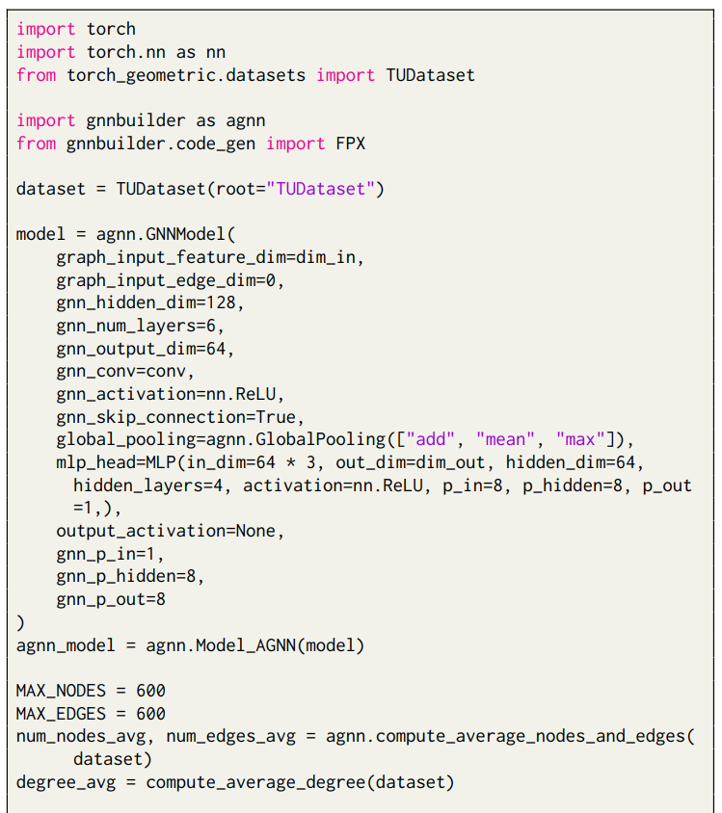
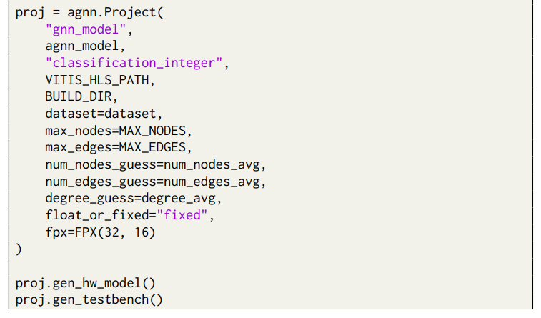
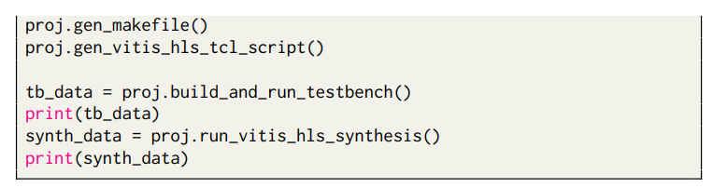
A Working Example using GNNBuilder
A minimum working example with:
GNN model definition
Training (omitted)
Code generation
Testbench generation
Synthesis and implementation

Slide 44
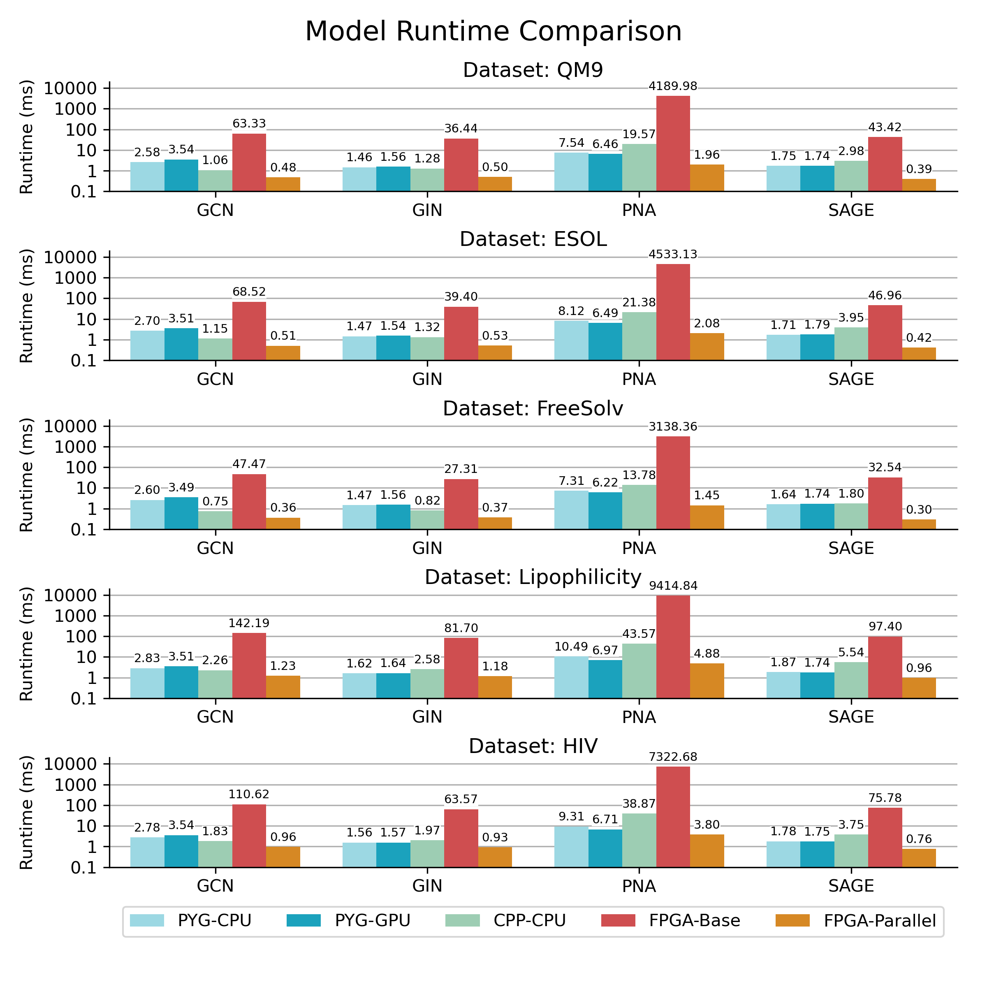
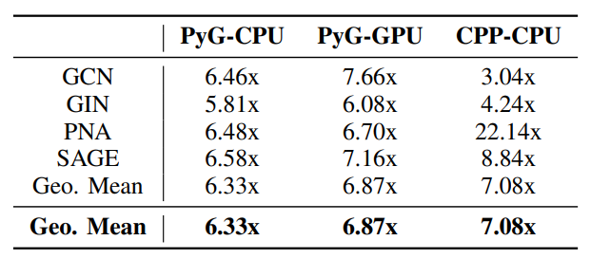
Implementation Results

Slide 45


GNNBuilder Source Code
Source Code + Documentation + Setup
pip install git+https://github.com/sharc-lab/gnn-builder.git
conda install --channel https://sharc-lab.github.io/gnn-builder/repo gnn-builder
Source Code
Documentation + Tutorials
github.com/sharc-lab/gnn-builder
sharc-lab.github.io/gnn-builder/

Slide 46
Summary
Ultra-low-latency GNN inference
Applications
  Point cloud for autonomous vehicles
  Spam and fraud detection
  High energy physics – microsecond, or even nanosecond
Implementations on FPGA
  Domain specific optimizations
  Design automation from standard PyTorch

Slide 47


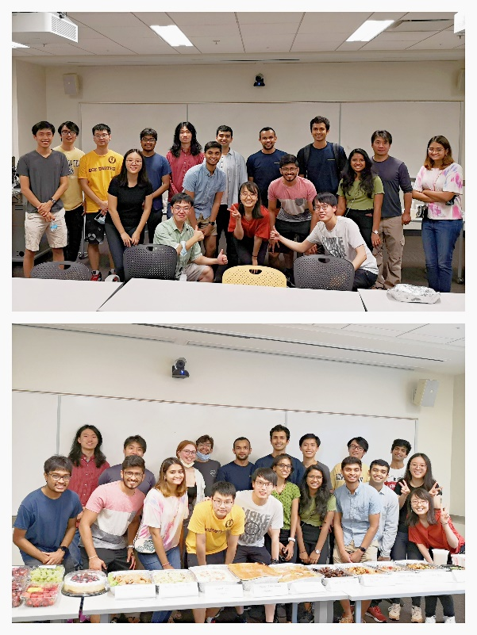
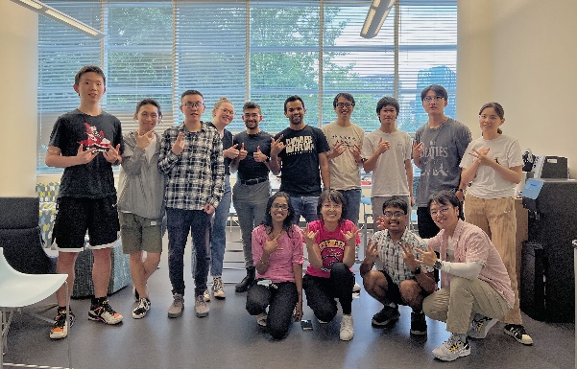
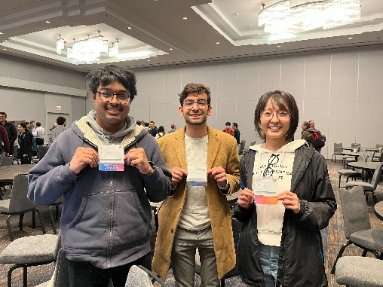
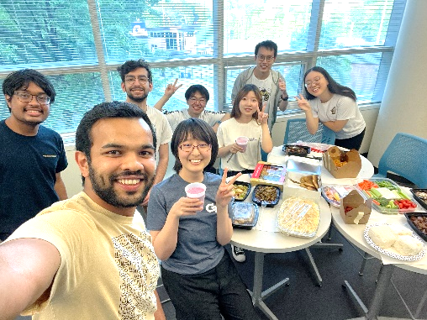
Contact
Software/Hardware Co-Design for Intelligence and Efficiency
  Email: callie.hao@ece.gatech.edu
  Homepage: http://sharclab.ece.gatech.edu

