Slide 1
Smart Reconfigurable Computing for GNNs and Transformers
ROAD4NN workshop @ DAC’23
Cong (Callie) Hao
Assistant Professor
Georgia Institute of Technology
School of Electrical and Computer Engineering
Sharc-lab @ Georgia Tech https://sharclab.ece.gatech.edu/

Slide 2
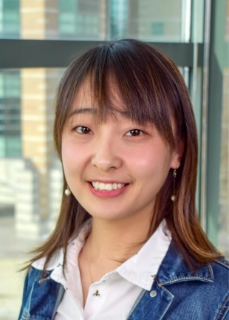
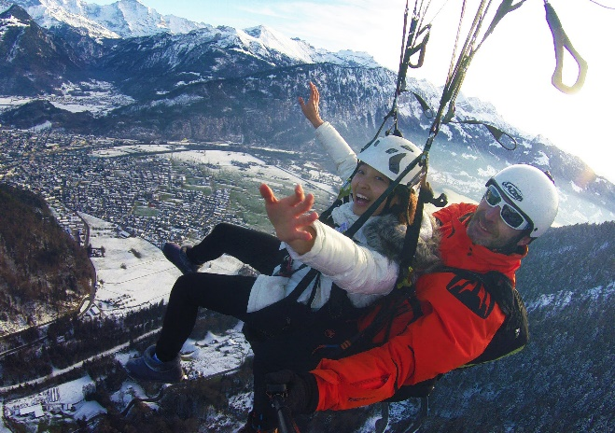
Self-Introduction
Cong (Callie) Hao
Assistant Professor at Georgia Tech ECE
Faculty Fellow at GT (2021~2022)
Postdoc at UIUC (2018~2020)
Ph.D. in Japan, Waseda University (2017)
Email: callie.hao@ece.gatech.edu
Homepage: http://callie.ece.gatech.edu

Slide 3
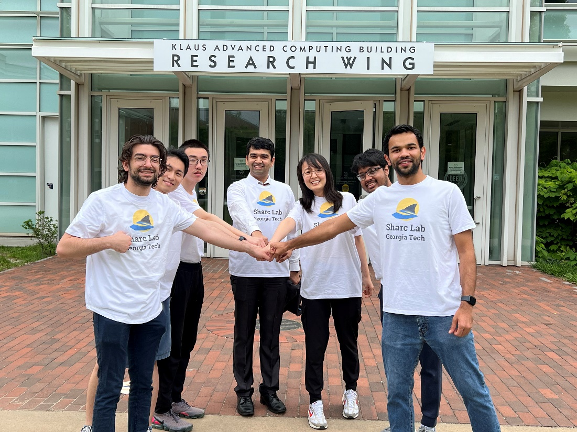
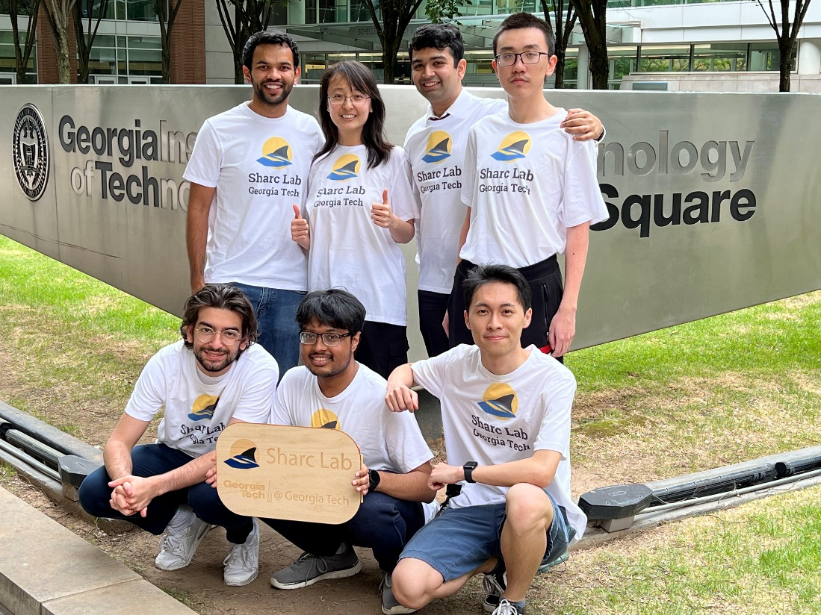
Self-Introduction
Sharc Lab
Software/Hardware Co-Design for Intelligence and Efficiency

Slide 4
Our ROAD4NN
EDA Tools
Architectures
FlowGNN: A generic Graph Neural Network (GNN) accelerator on FPGA
GNNBuilder: An automated GNN accelerator generator
Edge-MoE: Multi-task Vision Transformer (HW)
LightningSim: Fast and Accurate Trace-Based Simulation for High-Level Synthesis
DGNN-Booster: A Generic FPGA Accelerator Framework For Dynamic Graph Neural Network Inference
INR-Arch: A Dataflow Architecture and Compiler for Arbitrary-Order Gradient Computations

Slide 5
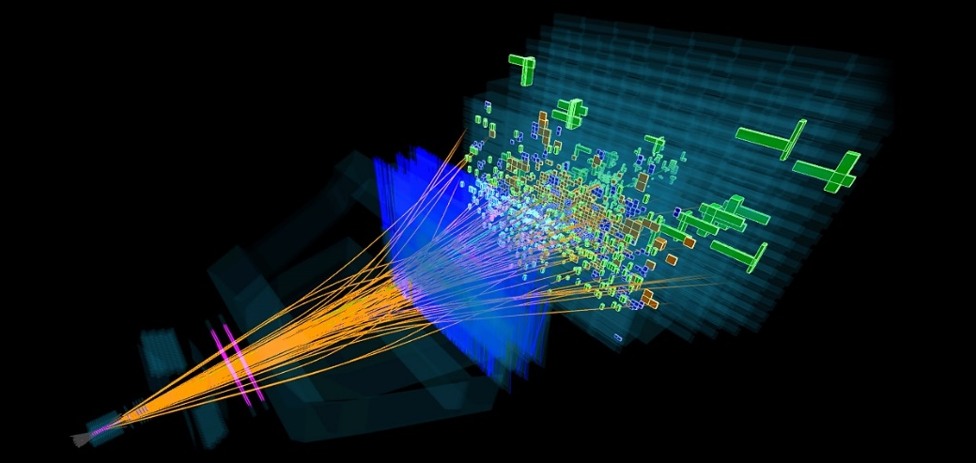
Our ROAD4NN
EDA Tools
Architectures
FlowGNN: A generic Graph Neural Network (GNN) accelerator on FPGA
HPCA’23
Written in Vitis HLS
Open-source
In collaboration with High Energy Physicists
[image source] https://www.quantamagazine.org/growing-anomalies-at-the-large-hadron-collider-hint-at-new-particles-20200526/
The first general GNN architecture with on-FPGA verification
Rishov Sarkar

Slide 6
Our ROAD4NN
EDA Tools
Architectures
GNNBuilder: An automated GNN accelerator generator
FPL’23
Open-source
From Standard PyTorch
The first automated GNN accelerator generator from standard PyTorch
Stefan Abi-Karam

Slide 7
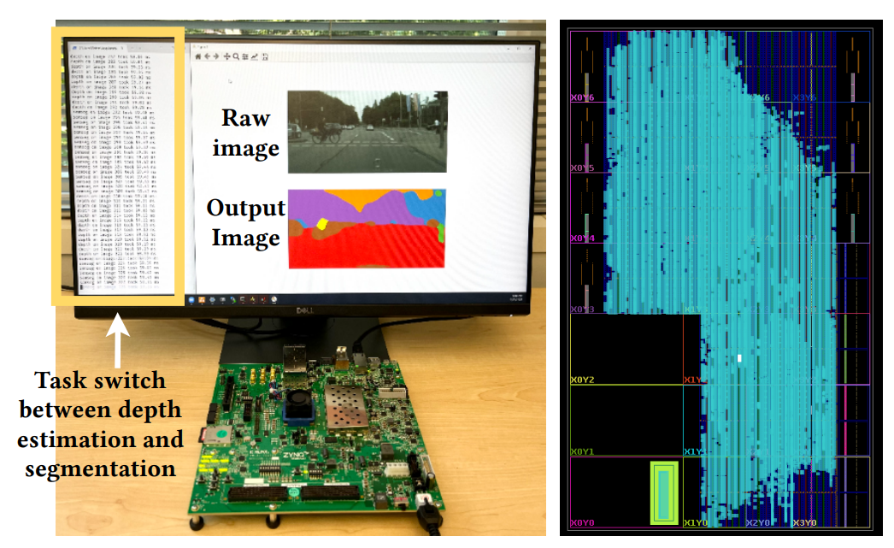
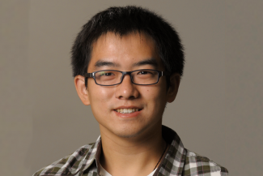
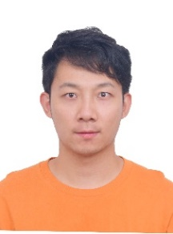
Our ROAD4NN
EDA Tools
Architectures
Under review
Written in Vitis HLS
Open-source
Edge-MoE: Multi-task Vision Transformer (HW)
The first multi-task learning with dynamic task-level sparsity!
Rishov Sarkar
UT Austin Team

Slide 8
Our ROAD4NN
EDA Tools
Architectures
HLS Synthesis
LightningSim⚡
LLVM IR
❶
IR Trace Generation
bitcode
(A) Make LLVM IR executable
Static
scheduling
(B) Make LLVM IR traceable
information
Execute modified IR and dump a trace
Dumped Trace
❷
IR Trace Analysis
Rishov Sarkar
(C) Trace parsing
(D) Resolving dynamic schedule
Change
Non-pipelined non-dataflow basic blocks
FIFO depth
LightningSim: Fast and Accurate Trace-Based Simulation for High-Level Synthesis
Dataflow basic blocks
Re-compute stalls
(E) Calculating stalls
without re-simulating
(unlike current HLS
(F) Modeling AXI interfaces
or simulation tools)
FCCM’23
Best Paper Runner-up
Open-source
The first HLS simulator with RTL-like accuracy and C-like speed

Slide 9
FlowGNN – A generic GNN architecture
EDA Tools
Architectures
FlowGNN: A generic Graph Neural Network (GNN) accelerator on FPGA
GNNBuilder: An automated GNN accelerator generator
Edge-MoE: Multi-task Vision Transformer (HW)
LightningSim: Fast and Accurate Trace-Based Simulation for High-Level Synthesis
DGNN-Booster: A Generic FPGA Accelerator Framework For Dynamic Graph Neural Network Inference
INR-Arch: A Dataflow Architecture and Compiler for Arbitrary-Order Gradient Computations

Slide 10
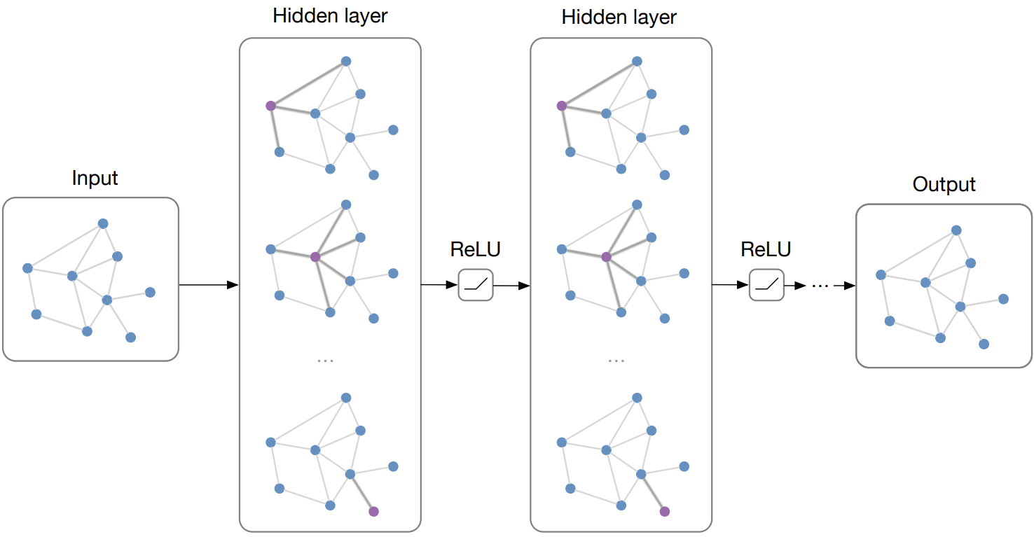
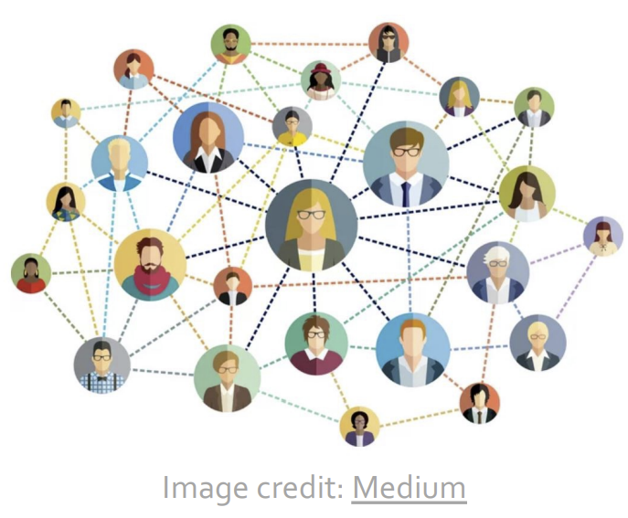
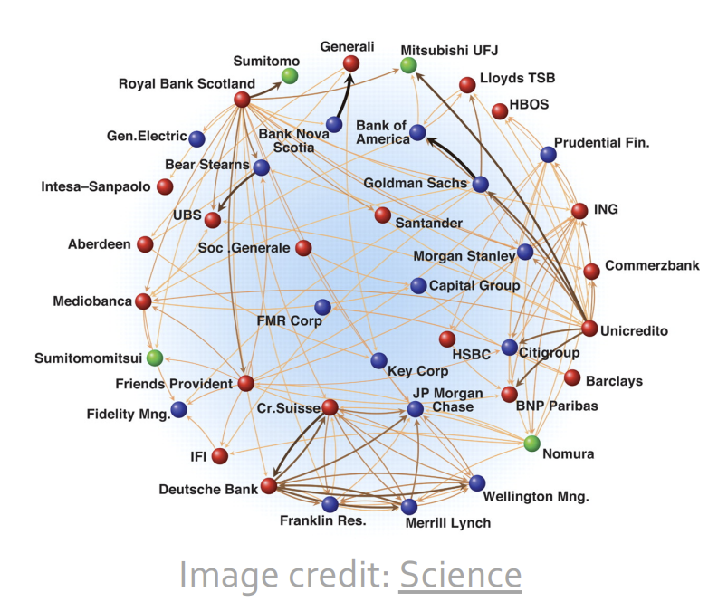
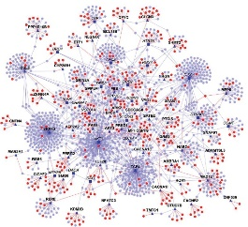
What are Graph Neural Networks (GNNs)?
[Slide credit: Structured deep models: Deep learning on graphs and beyond]

Slide 11
What are Graph Neural Networks (GNNs)?
[Slide credit: Structured deep models: Deep learning on graphs and beyond]

Slide 12
What are Graph Neural Networks (GNNs)?
$$n_{1}$$
❶ Send messages along all edges based on node and edge embeddings
$$n_{2}$$
$$x_{1}^{l}$$
$$e_{1→3}^{l}$$
$$=φ\left(.............,......\right)$$
Message Passing
$$𝒜\left(−, …, −\right)=m_{3}^{l}$$
❷ Aggregate incoming messages for each node
❸ Transform each node embedding using aggregated messages to get next layer node embedding
Node Transformation
$$n_{3}$$
$$γ\left(.............,m_{3}^{l}\right)=x_{3}^{l+1}$$
$$x_{3}^{l}$$
[Slide credit: Structured deep models: Deep learning on graphs and beyond]

Slide 13
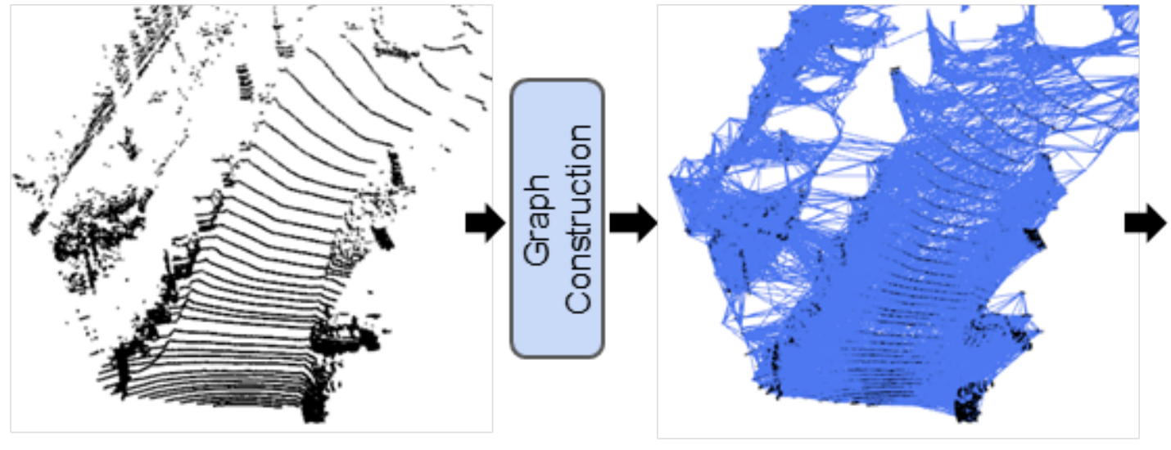
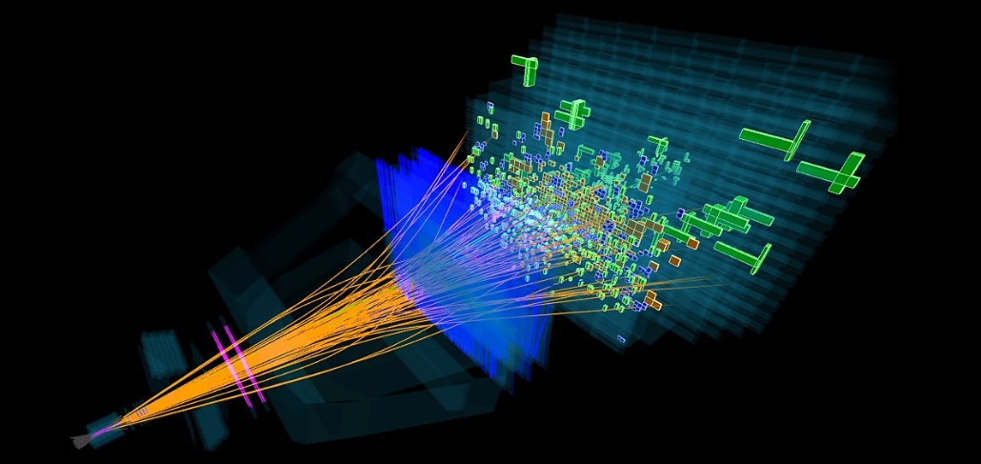
Real-time GNN Inference
Real-time Inference is required:
LiDAR and Point Cloud Data for Autonomous Driving
High Energy Physics
Fraud and spam detection
Sometimes nanosecond latency
[image source] Shi, Weijing, and Raj Rajkumar. "Point-gnn: Graph neural network for 3d object detection in a point cloud.“ CVPR 2020
[image source] https://www.quantamagazine.org/growing-anomalies-at-the-large-hadron-collider-hint-at-new-particles-20200526/

Slide 14
Existing Work
Most focus on Graph Convolution Network (GCN): A limited type
Heavy pre-processing: Not suitable for real-time
Most on ASIC via simulation: not end-to-end, far from practical

Slide 15
Existing Work vs. Ours
Most focus on Graph Convolution Network (GCN): A limited type
Support a wide range of GNNs: Generic
Heavy pre-processing: Not suitable for real-time
No pre-processing: Real-time oriented
FlowGNN: a dataflow-based architecture (HPCA’23)
High-Level Synthesis (HLS) based
Open sourced: https://github.com/sharc-lab/flowgnn
Most on ASIC via simulation: not end-to-end, far from practical
Evaluated end-to-end on FPGA

Slide 16
Message Passing in GNNs
$$x_{3}^{l}$$
$$n_{3}$$
$$n_{2}$$
$$x_{2}^{l}$$
$$x_{3}^{l+1}$$
$$n_{3}$$
$$n_{2}$$
$$x_{2}^{l+1}$$
GNN at layer $l$
$$e_{1,3}^{l}$$
GNN at layer $l+1$
$$e_{1,3}^{l+1}$$
$e_{1,2}^{l}$: Edge Embedding
$e_{1,2}^{l+1}$: Edge Embedding
$$x_{4}^{l}$$
$$n_{4}$$
$$n_{1}$$
$x_{1}^{l}$: Node Embedding
$$x_{4}^{l+1}$$
$$n_{4}$$
$$n_{1}$$
$x_{1}^{l+1}$: Node Embedding
$$e_{1,4}^{l}$$
$$e_{1,4}^{l+1}$$
$m_{1}^{l}$: Aggregated Message
$$φ($$
$$x_{1}^{l+1}$$
$$,$$
$$e_{1,2 }^{l+1}$$
$$m_{1→2}^{l+1}$$
Msg.
Buffer
1/2
Size:
O(N)
$$)$$
Msg.
Buffer
2/1
Size:
O(N)
$$m_{2→1}^{l}$$
$$x_{1}^{l}$$
$$γ(x_{1}^{l}, m_{1}^{l})$$
$$x_{1}^{l+1}$$
$$φ($$
$$x_{1}^{l+1}$$
$$,$$
$$e_{1,3 }^{l+1}$$
$$m_{1→3}^{l+1}$$
$$m_{1}^{l}$$
$$)$$
$$m_{3→1}^{l}$$
$$𝒜(⋅)$$
$$φ($$
$$x_{1}^{l+1}$$
$$,$$
$$e_{1,4 }^{l+1}$$
$$m_{1→4}^{l+1}$$
$$m_{4→1}^{l}$$
$$)$$
Aggregation
Node Transformation
Update
Message Transformation
Message Passing (Gather)
Node Transformation (NT)
Message Passing (Scatter)

Slide 17
Message Passing in GNNs
$$x_{3}^{l}$$
$$n_{3}$$
$$n_{2}$$
$$x_{2}^{l}$$
$$x_{3}^{l+1}$$
$$n_{3}$$
$$n_{2}$$
$$x_{2}^{l+1}$$
GNN at layer $l$
$$e_{1,3}^{l}$$
GNN at layer $l+1$
$$e_{1,3}^{l+1}$$
$e_{1,2}^{l}$: Edge Embedding
$e_{1,2}^{l+1}$: Edge Embedding
$$x_{4}^{l}$$
$$n_{4}$$
$$n_{1}$$
$x_{1}^{l}$: Node Embedding
$$x_{4}^{l+1}$$
$$n_{4}$$
$$n_{1}$$
$x_{1}^{l+1}$: Node Embedding
$$e_{1,4}^{l}$$
$$e_{1,4}^{l+1}$$
Node Transformation (NT)
Edge Embedding (EE)
+ Message Passing (MP)
$m_{1}^{l}$: Aggregated Message
Multi
-
•
layer Perceptron
+
•
Activation
Node
’s
Edge
’s embedding
$$x_{1}^{l+1}$$
$$e_{1,2 }^{l+1}$$
$$m_{1→2}^{l+1}$$
$$φ($$
(
)
Msg.
Buffer
1/2
Size:
O(N)
Self
𝒏
𝟏
𝒏
𝟏
𝒏
𝟐
$$,$$
$$)$$
Msg.
Buffer
2/1
Size:
O(N)
-
$$m_{2→1}^{l}$$
•
attention
embedding
+
,
$$x_{1}^{l}$$
Edge
’s embedding
$$γ(x_{1}^{l}, m_{1}^{l})$$
$$x_{1}^{l+1}$$
$$φ($$
$$x_{1}^{l+1}$$
$$,$$
$$e_{1,3 }^{l+1}$$
$$m_{1→3}^{l+1}$$
(
)
$$)$$
$$m_{1}^{l}$$
Sequentially
𝒏
𝟏
𝒏
𝟑
$$m_{3→1}^{l}$$
$$𝒜(⋅)$$
+
,
Edge
’s embedding
$$x_{1}^{l+1}$$
$$e_{1,4 }^{l+1}$$
$$m_{1→4}^{l+1}$$
$$φ($$
(
)
𝒏
𝟏
𝒏
$$,$$
$$)$$
$$m_{4→1}^{l}$$
,
𝟒
Aggregation
Node Transformation
Update
Message Transformation
Message Passing (Gather)
Node Transformation (NT)
Message Passing (Scatter)

Slide 18
Architecture to Support Message Passing

Slide 19
Architecture to Support Message Passing

Slide 20
Pipelining Strategies
NT: Node Transformation
MP: Message Passing
(a) Non-pipeline
NT
MP
(b) Fixed pipeline
NT
1
2
3
4
Idle time because of imbalanced NT and MP
MP
1
2
3
4
(c) Baseline dataflow pipeline
NT
1
2
3
4
Node queue for message passing
MP
1
2
3
4

Slide 21
Pipelining Strategies
Can we do better?
How can we NOT sacrifice performance for generality?
Drawback: no node/edge level parallelism: one by one is too slow!
(c) Baseline dataflow pipeline
NT
1
2
3
4
Node queue for message passing
MP
1
2
3
4

Slide 22
(c) Baseline dataflow pipeline
NT
1
2
3
4
Node queue for message passing
MP
1
2
3
4
(d) FlowGNN pipeline with multiple NT/MP
NT1
1
3
NT2
2
4
MP1
MP2
MP3
MP4

Slide 23
FlowGNN pipeline with node/edge parallelism
(d) FlowGNN pipeline with multiple NT/MP
NT1
1
3
NT2
2
4
MP1
MP2
MP3
MP4

Slide 24
FlowGNN pipeline with node/edge parallelism
(d) FlowGNN pipeline with multiple NT/MP
NT1
1
3
NT2
2
4
Challenge: how to avoid bank conflicts?
MP1
MP1
1
MP2
3
MP3
MP2
2
MP1 and MP2 must both write to this node!
MP4

Slide 25
FlowGNN pipeline with node/edge parallelism
Solution: each MP unit is responsible for a unique set of destination nodes
1
MP3
3
2
NT1
1
3
NT2
2
4
Challenge: how to avoid bank conflicts?
MP1
MP1
1
MP2
3
MP3
MP2
2
MP1 and MP2 must both write to this node!
MP4
Notes:
We can make each MP unit responsible for its own set of destination nodes and have it process all its incoming edges. This way, no two MP units will have to write to the same memory bank.

Slide 26
FlowGNN pipeline with node/edge parallelism
Challenge: how to stream nodes from multi-NT to multi-MP?
Solution: each MP unit is responsible for a unique set of destination nodes
MP1
1
MP3
NT1
MP2
3
NT2
MP3
2
MP4
Challenge: how to avoid bank conflicts?
MP1
1
3
MP2
2
MP1 and MP2 must both write to this node!
Notes:
But now we can’t have a simple node queue anymore. How can we stream nodes from multiple NT units to multiple MP units, keeping in mind the destination node scheme I just mentioned?

Slide 27
FlowGNN pipeline with node/edge parallelism
Challenge: how to stream nodes from multi-NT to multi-MP?
Solution: each MP unit is responsible for a unique set of destination nodes
MP1
1
MP3
NT1
MP2
3
NT2
MP3
2
MP4
Solution: multi-queue multicasting NT-to-MP adapter
Challenge: how to avoid bank conflicts?
MP1
NT to MP
Q
MP1
1
NT1
Q
Q
MP2
3
NT2
Q
Q
MP3
MP2
2
MP1 and MP2 must both write to this node!
Q
MP4
Notes:
That’s where the multi-queue multicasting NT-to-MP adapter comes in. This thing will take one queue from each NT unit and distribute node data to separate queues for each MP unit.

Slide 28
FlowGNN pipeline with node/edge parallelism
Challenge: how to stream nodes from multi-NT to multi-MP?
MP1
NT1
MP2
NT2
MP3
NT1
1
3
MP4
NT2
2
4
Multi-queue multicasting adapter
Solution: multi-queue multicasting NT-to-MP adapter
MP1
MP1’s destination nodes
MP2
MP2’s destination nodes
NT to MP
Q
MP1
NT1
Q
MP3
MP3’s destination nodes
Q
MP2
NT2
Q
MP4
MP4’s destination nodes
Q
MP3
Q
MP4

Slide 29
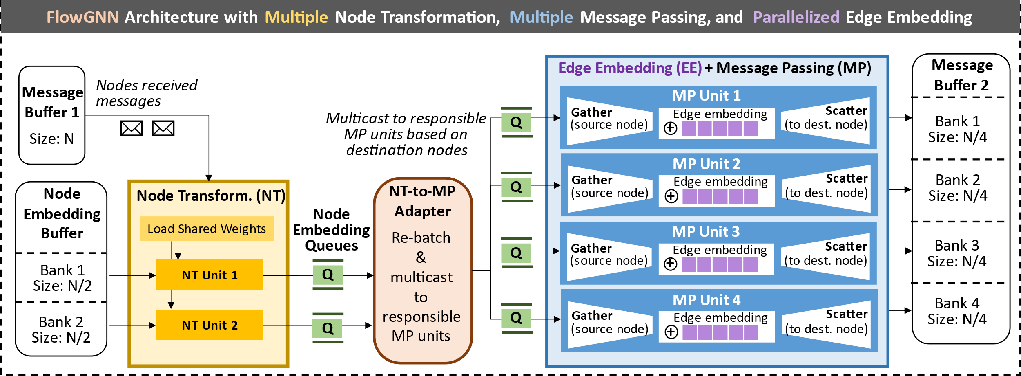
FlowGNN: Parallelized Architecture
Notes:
So now we can see the full FlowGNN architecture, with multiple node transformation units and multiple message passing units, all working in parallel.

Slide 30
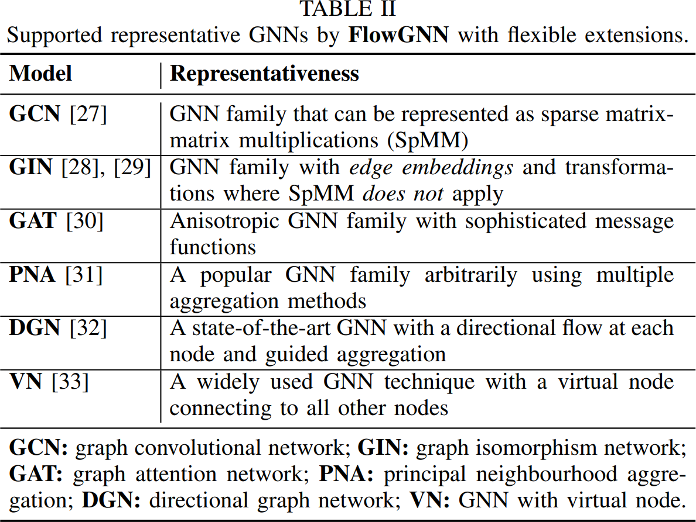
Experiment Setup
Evaluated on six GNN models
Notes:
We evaluate FlowGNN on six models, which are each representative of a family of GNNs. For instance, GAT represents the family of GNNs with anisotropic message passing, and PNA represents GNNs using multiple aggregation methods.

Slide 31
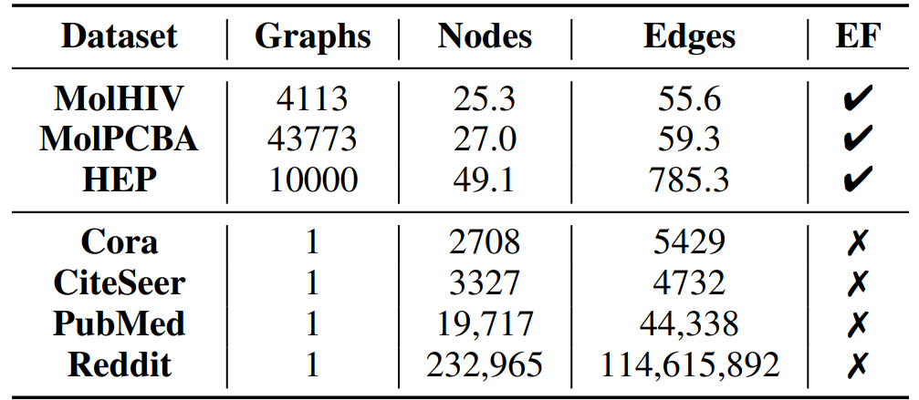
Experiment Setup
Evaluated end-to-end on-board on Xilinx Alveo U50 @ 300 MHz
CPU baseline: Intel Xeon Gold 6226R (batch size 1)
GPU baseline: NVIDIA RTX A6000 (batch size 1 ~ 1024)
Evaluated on seven datasets, including one from High-Energy Physics
Notes:
We evaluate our framework end-to-end on the Xilinx Alveo U50 Acceleration Board, targeting a 300 MHz clock frequency.
We compare against the CPU and GPU baselines shown, and we use seven datasets: two molecular datasets of lots of thousands of small graphs, four larger single graph datasets, and one dataset of 10,000 graphs from High-Energy Physics.

Slide 32
Evaluation – End-to-end Latency
(
a
)
M
o
l
H
I
V
GIN
FlowGNN: 0.05ms
On GPU: batch size from 1 to 1024
Notes:
Here we show comparisons on our molecular datasets against GPU and CPU baselines. We see that FlowGNN achieves 50 to 250 times speedup over CPU and 50 to 480 times speedup over GPU at batch size one.
Although batch size 1 is the only fair comparison in a real-time setting, we also compare against GPU at higher batch sizes, and we still see speedup on all models and both datasets up to batch size 64.
The FlowGNN GAT and DGN models even beat GPU at batch size 1024.

Slide 33
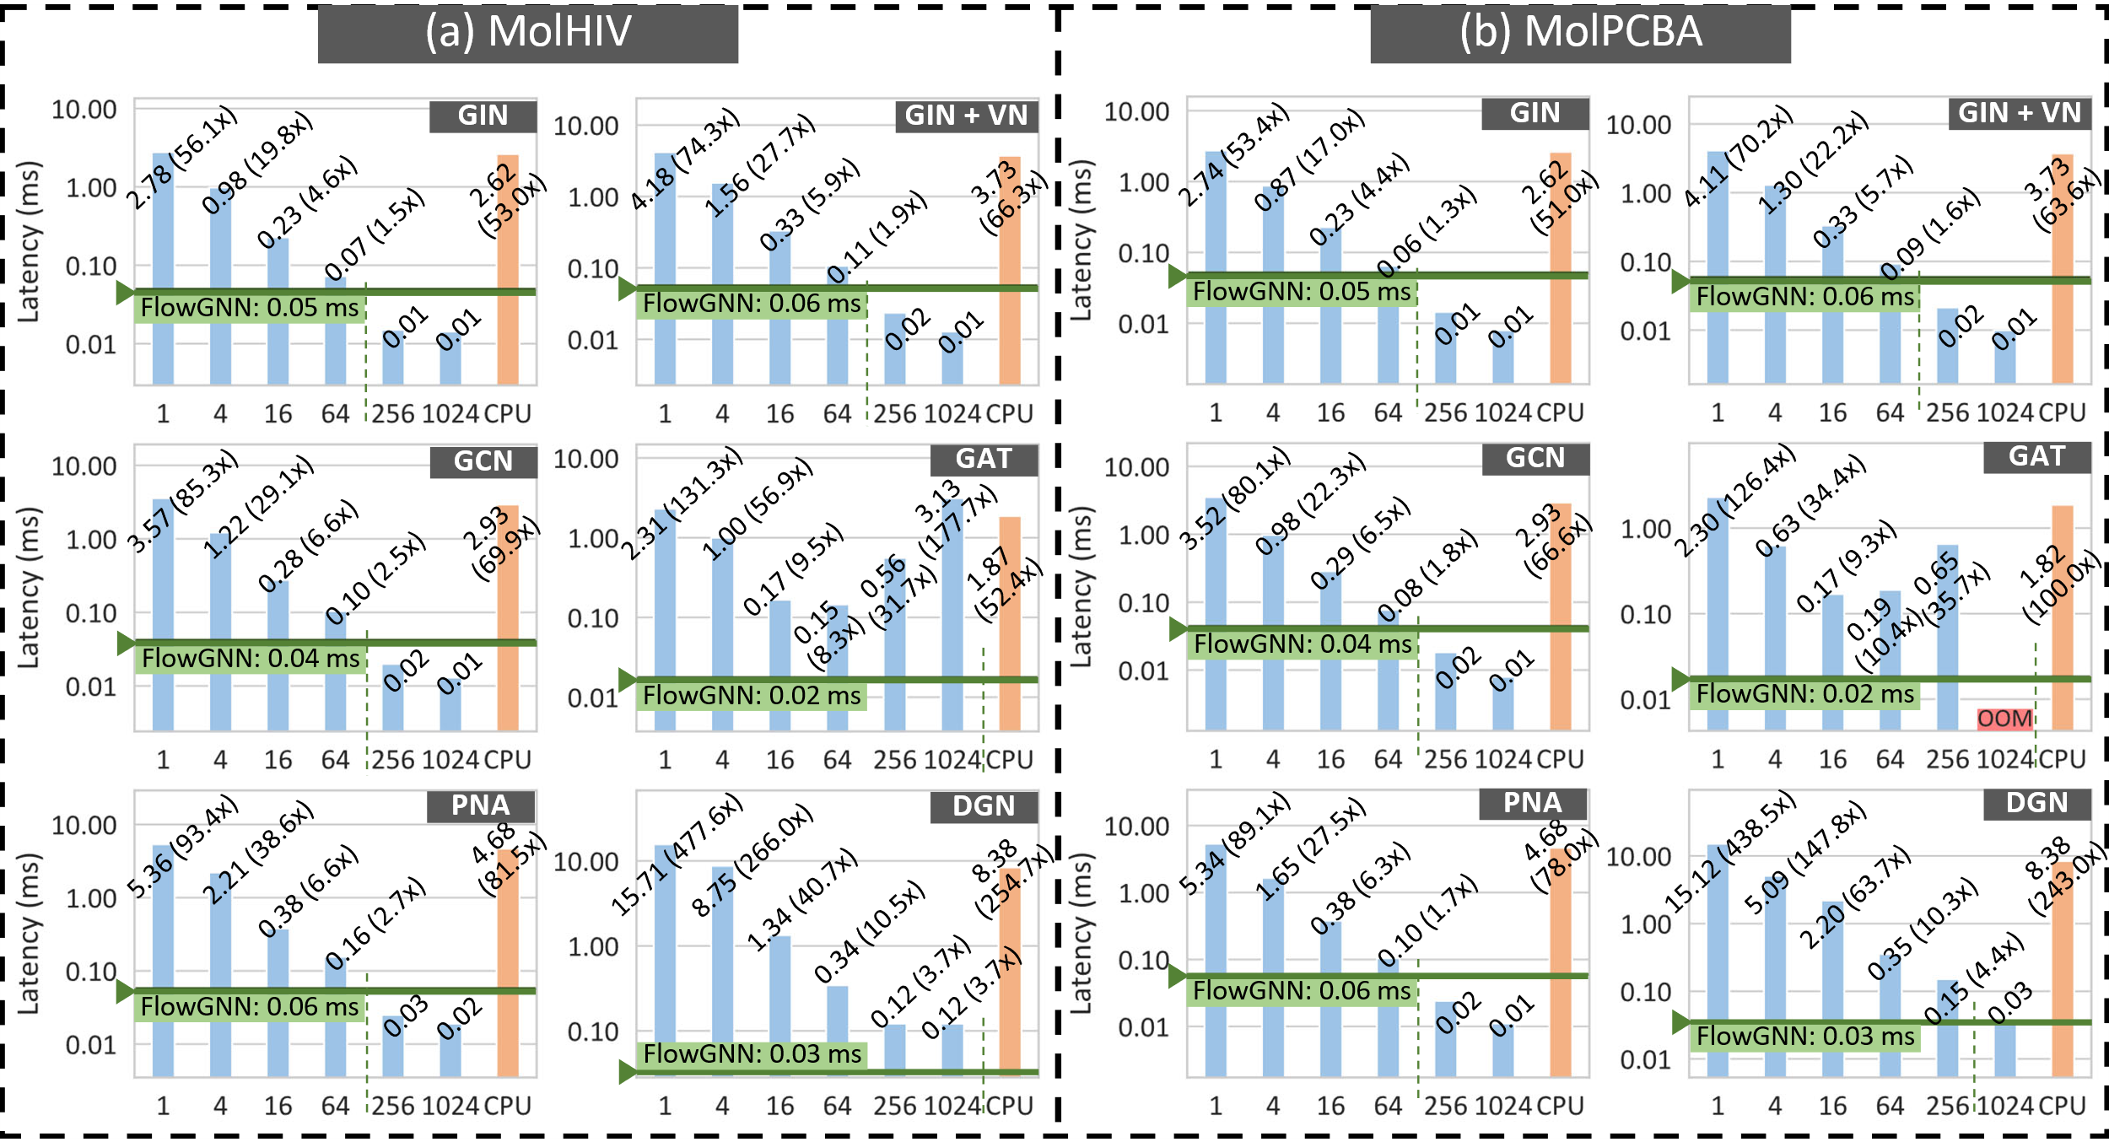
Evaluation – End-to-end Latency
Notes:
Here we show comparisons on our molecular datasets against GPU and CPU baselines. We see that FlowGNN achieves 50 to 250 times speedup over CPU and 50 to 480 times speedup over GPU at batch size one.
Although batch size 1 is the only fair comparison in a real-time setting, we also compare against GPU at higher batch sizes, and we still see speedup on all models and both datasets up to batch size 64.
The FlowGNN GAT and DGN models even beat GPU at batch size 1024.

Slide 34
Evaluation – End-to-end Latency
Observations:
FlowGNN is 50~250x over CPU, 50~480x over GPU at bs=1
For all models, FlowGNN outperform GPU for bs<=64
For GAT and DGN, FlowGNN beats GPU at bs=1024
Notes:
Here we show comparisons on our molecular datasets against GPU and CPU baselines. We see that FlowGNN achieves 50 to 250 times speedup over CPU and 50 to 480 times speedup over GPU at batch size one.
Although batch size 1 is the only fair comparison in a real-time setting, we also compare against GPU at higher batch sizes, and we still see speedup on all models and both datasets up to batch size 64.
The FlowGNN GAT and DGN models even beat GPU at batch size 1024.

Slide 35
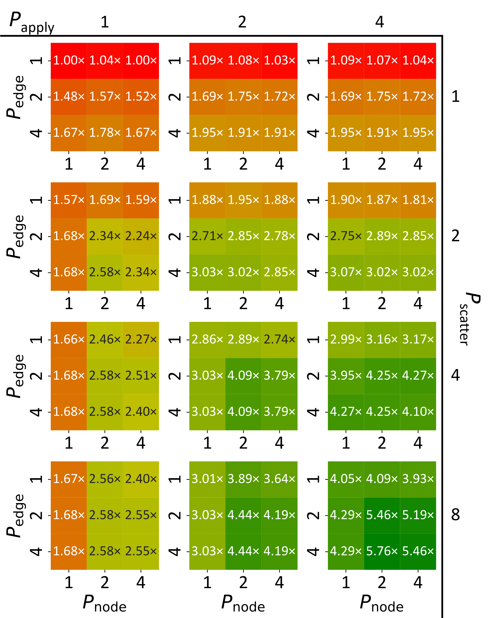
Design Space Exploration
Four reconfigurable parameters
# of nodes in parallel: P_{node}
# of edges in parallel: P_{edge}
# of elements in NT: P_{apply}
# of elements in MP: P_{scatter}
Speedup is non-linear with respect to different parallelism factors
An increase in one parameter does not guarantee speedup
Future work
Notes:
We also do a preliminary design space exploration to look at how changing parallelism factors changes the latency. We found that the parallelism factors have a non-linear and entangled effect, where sometimes increasing one parameter doesn’t necessarily change the latency whereas changing a different parameter does.

Slide 36
GNNBuilder – An automated GNN builder
EDA Tools
Architectures
FlowGNN: A generic Graph Neural Network (GNN) accelerator on FPGA
GNNBuilder: An automated GNN accelerator generator
Edge-MoE: Multi-task Vision Transformer (HW)
LightningSim: Fast and Accurate Trace-Based Simulation for High-Level Synthesis
DGNN-Booster: A Generic FPGA Accelerator Framework For Dynamic Graph Neural Network Inference
INR-Arch: A Dataflow Architecture and Compiler for Arbitrary-Order Gradient Computations

Slide 37
GNN Builder Workflow
A fully-automated, end-to-end GNN accelerator generation on FPGA
Standard PyTorch input, FPGA bitstream + hostcode output

Slide 38
GNN Builder Features
Generic: Wide range of GNN model types (follows FlowGNN principle)
Flexible: Highly customizable GNN models
Standard and Extensible API: Standard PyTorch as inputs
Completeness: Multi-level tasks (node, link, graph) with end-to-end workflow
DSE: Accelerator design space exploration (DSE) and optimization
Deployment: End-to-end with host code
Performance: Better than CPU and GPU

Slide 39
Feature 1 – Generic
General / Sparse Matrix Multiplication (SpMM) is NOT all we need!
Supported GNNs:
GCN: can be represented as SpMM
GraphSage with flexible non-sum aggregation – not SpMM
GIN with edge embedding – not SpMM
PNA with multiple aggregation – not SpMM
GAT with attention – not SpMM

Slide 40
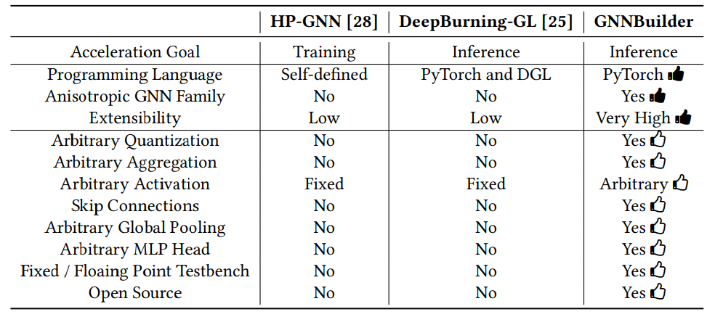
Feature 2 – Flexible

Slide 41
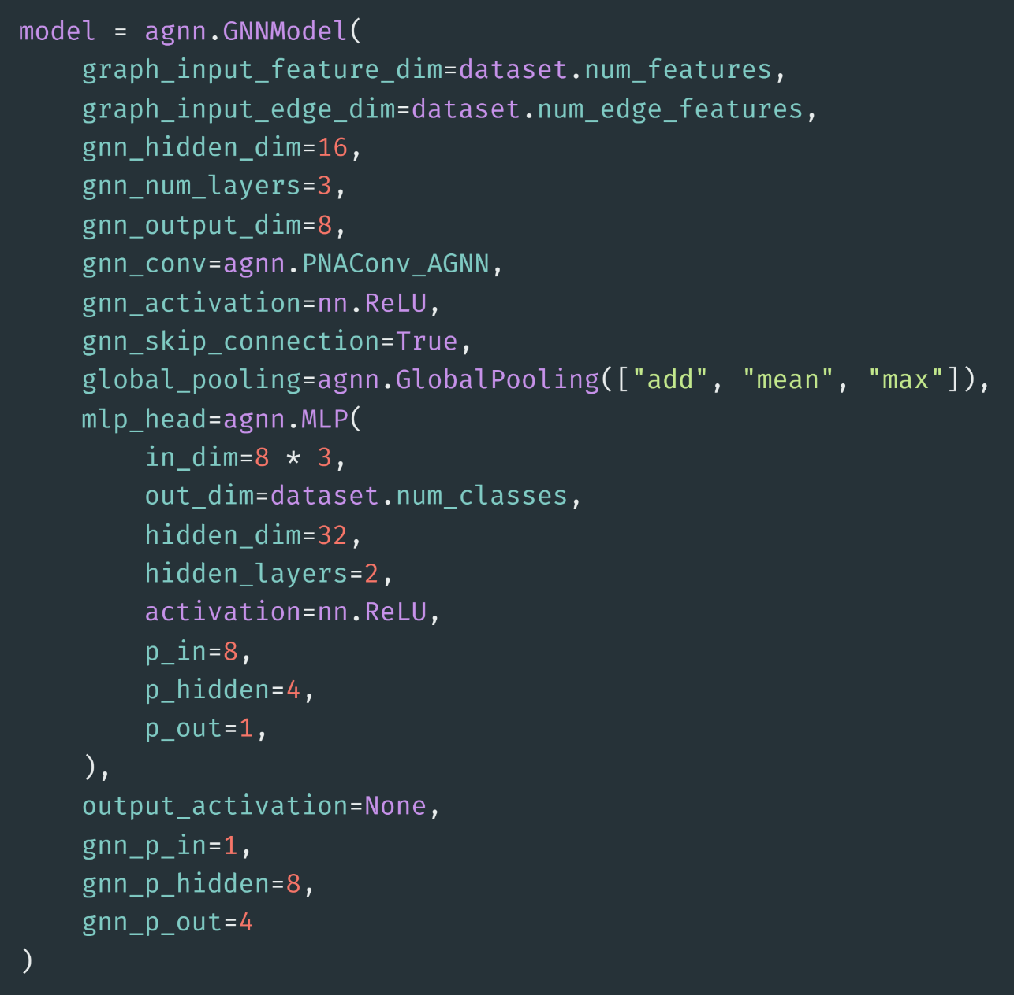
Feature 3 – Standard PyTorch API
Create a fully parameterized GNN model using native PyTorch Geometric layers
Behaves as a standard nn.Module
Zero gap from training to deployment

Slide 42
Feature 3 – Standard PyTorch API (cont.)
(SW)
Model and layer definition
(HW)
HLS code generation and deployment on FPGA

Slide 43
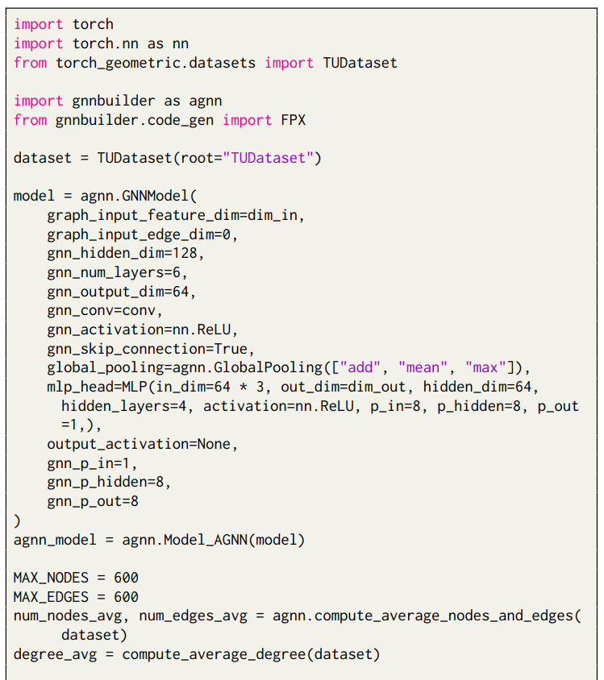
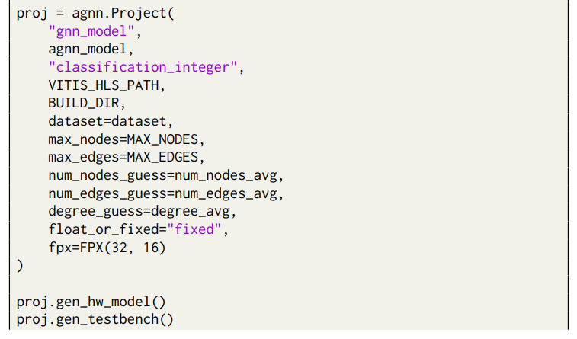
A Working Example using GNNBuilder
A minimum working example with:
GNN model definition
Training (omitted)
Code generation
Testbench generation
Synthesis and implementation

Slide 44
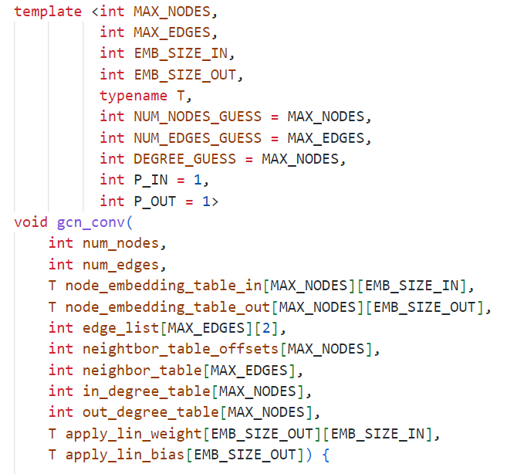
Underneath of GNNBuilder – Templates
Pre-defined static array size
Define fixed-point data precision
Used for latency estimation
(can be omitted in deployment)
Linear layer parallelism
(can be decided by DSE later)

Slide 45
Design Space Exploration (DSE)
How can I predict a given model’s resource usage and latency?
Analytical Model
Look at HLS code and calculate a rough estimate of clock cycles and resources
Failed: Too much complexity in HLS synthesis, mapping, and dynamic runtime
ML-based Model
Use random forest on a dataset of 400 randomly sampled model designs + configurations
Success!

Slide 46
DSE Results – Analytical v.s. Analytical + ML

Slide 47
DSE Results – ML based

Slide 48
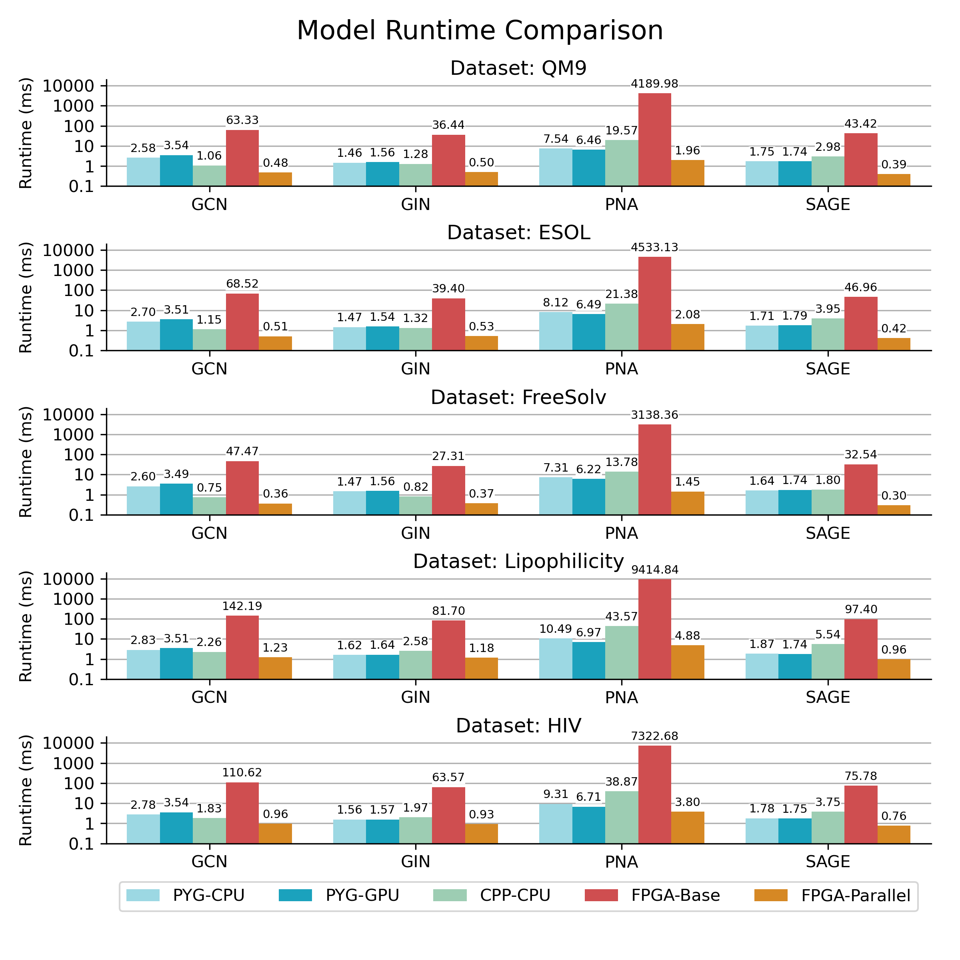
Implementation Results

Slide 49
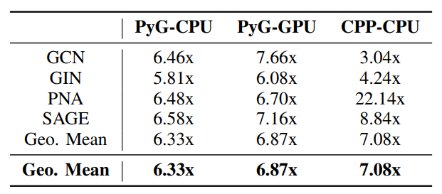
Implementation Results (cont.)
GNNBuilder is 6$×$ faster than CPU/GPU at batch size 1

Slide 50
GNNBuilder Limitations and Future Work
FlowGNN is 3$×$ – 400$×$ GPU speed up, GNNBuilder maxed out at 3$×$
Core Issues
No dataflow or steaming optimizations
Simple HW implementation requires many unnecessary buffers and data copying
No node-level parallelism
Each node is evaluated sequentially, nodes are not processed in parallel
Parallelism only exists in linear layers
Solutions
Refactor HLS design using #pragma dataflow inside GNN conv layers
Integrate node-level parallelism ideas from FlowGNN
Will open source soon!

Slide 51
Edge-MoE – A multi-task vision transformer
EDA Tools
Architectures
FlowGNN: A generic Graph Neural Network (GNN) accelerator on FPGA
GNNBuilder: An automated GNN accelerator generator
Edge-MoE: Multi-task Vision Transformer (HW)
LightningSim: Fast and Accurate Trace-Based Simulation for High-Level Synthesis
DGNN-Booster: A Generic FPGA Accelerator Framework For Dynamic Graph Neural Network Inference
INR-Arch: A Dataflow Architecture and Compiler for Arbitrary-Order Gradient Computations

Slide 52
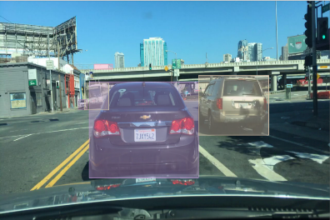
Single-Task Learning (STL) for Multi-tasking
Original Video

Slide 53
Multi-Task Learning (MTL) for Multi-tasking
Original Video

Slide 54
Vision Transformer (ViT)
Attention
MLP
Attention
MLP
…
Vision transformer Encoder
Original Video
What about ViT for multi-tasking?
Patches

Slide 55
Challenges of MTL + ViT
Attention
MLP
Attention
MLP
…
Original Video
Patches
Vision transformer Encoder

Slide 56
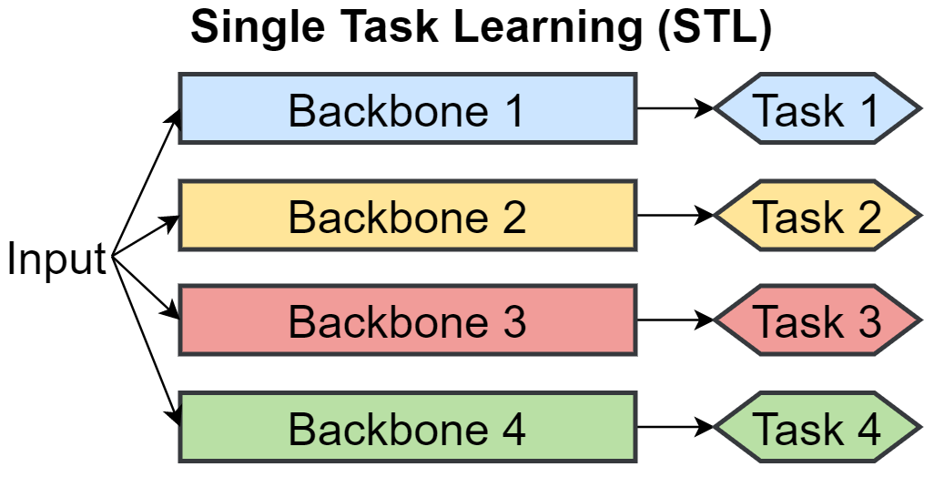
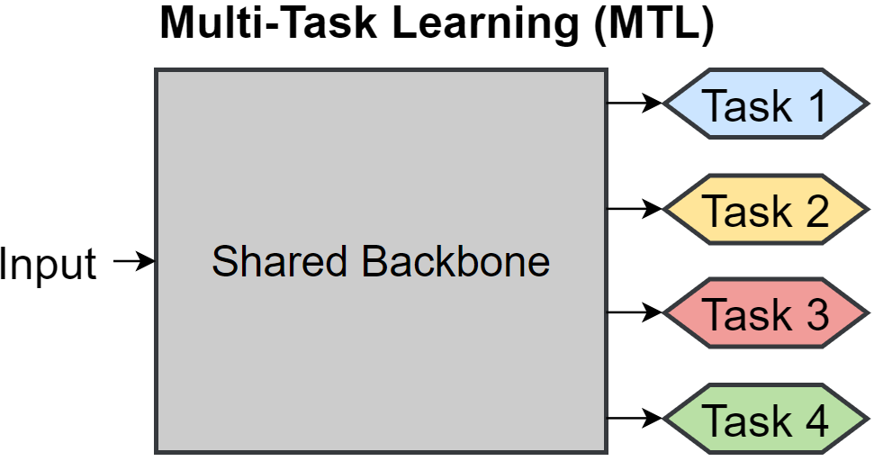
STL v.s. MTL
Running a single task can only activate one backbone
Usually lower accuracy comparing to MTL
Higher accuracy comparing to STL
Running only one task needs to activate the entire shared backbone

Slide 57
STL v.s. MTL
Running a single task can only activate one backbone
Usually lower accuracy comparing to MTL
Higher accuracy comparing to STL
Running only one task needs to activate the entire shared backbone

Slide 58
STL v.s. MTL
Use Mixture-of-Expert (MoE):
dynamically select a sub-model
M3ViT
Edge-MoE

Slide 59
M3ViT: MTL + ViT + MoE
Attention
MLP
Original Video
Patches

Slide 60
M3ViT: MTL + ViT + MoE
Attention
MoE
Expert 1
Expert 2
Expert 3
Expert 4
Original Video
…
Expert N
Patches

Slide 61
M3ViT: MTL + ViT + MoE
Attention
MoE
Expert 1
Router
Task A
Expert 2
Expert 3
Expert 4
Original Video
…
Router
Task B
Expert N
Patches

Slide 62
M3ViT: MTL + ViT + MoE
Attention
MoE
Expert 1
Router
Task A
Expert 2
Expert 3
Expert 4
Task-level sparsity saves a lot of memory and computation
Original Video
…
Router
Task B
Expert N
Patches
Each task only select k out of N experts

Slide 63
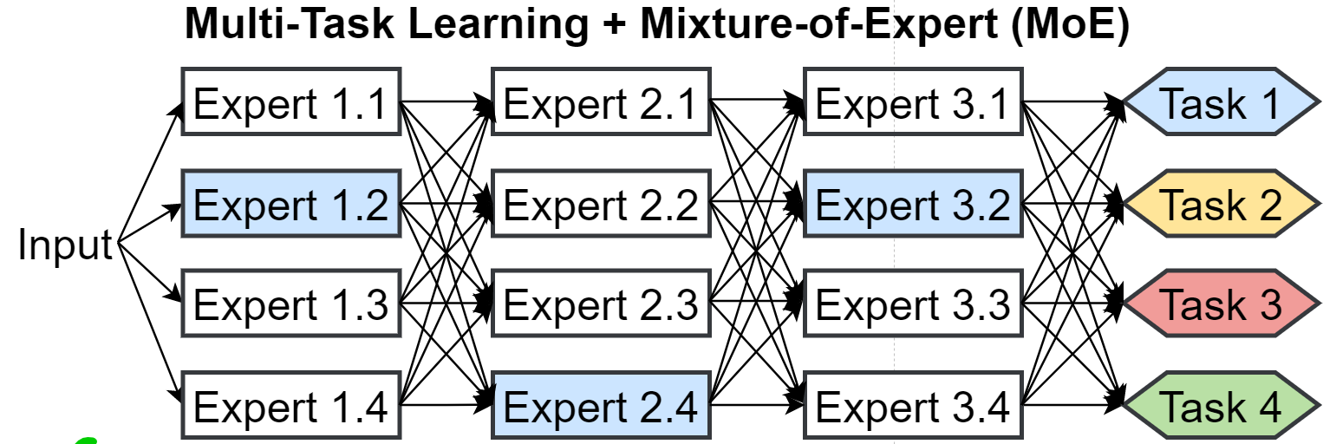
STL v.s. MTL. v.s. M3ViT

Slide 64
M3ViT: MTL + ViT + MoE
Algorithm guy is happy now:
MoE disentangles the parameter spaces and automatically avoids different tasks’ training conflict
Hardware guy is also happy:
Load the required experts only – memory efficient
But… there are still challenges
Expert 1
Router
Task A
Expert 2
Expert 3
Expert 4
…
Router
Task B
Expert N
Each task only select k out of N experts

Slide 65
MTL + ViT + MoE Challenge on Hardware
1
4
Load expert 1 and 4
2
8
Evict expert 1 and 4, load expert 2 and 8
4
6
Evict expert 2 and 8, load expert 4 and 6
9
7
…
2
1
3
5
Large data loading overhead!
6
1
7
3
2
4
5
1
Original Video
4
2
3
5
1
4
Patches even within the same task will select different experts…
7
5
6
8
Patches
2
3

Slide 66
MTL + ViT + MoE + FPGA
1
4
2
8
4
6
9
7
2
1
3
5
6
1
Solution:
Patch Reordering!
7
3
2
4
5
1
Original Video
4
2
3
5
1
4
7
5
6
8
Patches
2
3

Slide 67
MTL + ViT + MoE + FPGA
1
4
2
8
Load expert
1
4
6
Compute patch 1, 5, 7, 10, 13
9
7
2
1
3
5
6
1
7
3
2
4
5
1
Original Video
4
2
3
5
1
4
7
5
6
8
Patches
2
3

Slide 68
MTL + ViT + MoE + FPGA
1
4
2
8
Load expert
1
4
6
Compute patch 1, 5, 7, 10, 13
9
7
2
1
3
5
Load expert
2
6
1
Compute patch 2, 5, 9, 11, 16
7
3
2
4
…
5
1
Original Video
4
2
A Patch is much smaller than an Expert
3
5
1
4
7
5
6
8
Patches
2
3

Slide 69
MTL + ViT + MoE + FPGA Evaluation
On PASCAL-Context (simulated FPGA results)
Methods | FLOPS ↓ | Energy↓ | MTL Δ ↑ | Norm | H. Parts | Sal. | Edge | Seg
MTL-Baseline | 167 | 1.029 | 0 | 14.9 | 58.6 | 65.1 | 69.2 | 63.8
MTAN | 212 | 5.306 | +0.47 | 14.8 | 58.9 | 65.4 | 69.6 | 63.7
Cross-Stitch | 647 | 6.001 | +3.46 | 13.9 | 60.6 | 66.8 | 69.9 | 66.1
NDDR-CNN | 747 | 5.034 | +3.25 | 13.9 | 60.5 | 66.8 | 69.8 | 65.4
MTL ViT | 83 | 3.062 | +1.09 | 15.5 | 58.7 | 64.9 | 68.8 | 70.7
M²ViT (+MoE) | 84 | 7.446 | +5.57 | 14.5 | 62.1 | 66.3 | 71.7 | 72.8
M³ViT (+Codesign) | 84 | 0.690 | +5.57 | 14.5 | 62.1 | 66.3 | 71.7 | 72.8

Slide 70
MTL + ViT + MoE + FPGA Evaluation
ViT beats ResNet
Methods | FLOPS ↓ | Energy↓ | MTL Δ ↑ | Norm | H. Parts | Sal. | Edge | Seg
MTL-Baseline | 167 | 1.029 | 0 | 14.9 | 58.6 | 65.1 | 69.2 | 63.8
MTAN | 212 | 5.306 | +0.47 | 14.8 | 58.9 | 65.4 | 69.6 | 63.7
Cross-Stitch | 647 | 6.001 | +3.46 | 13.9 | 60.6 | 66.8 | 69.9 | 66.1
NDDR-CNN | 747 | 5.034 | +3.25 | 13.9 | 60.5 | 66.8 | 69.8 | 65.4
MTL ViT | 83 | 3.062 | +1.09 | 15.5 | 58.7 | 64.9 | 68.8 | 70.7
M²ViT (+MoE) | 84 | 7.446 | +5.57 | 14.5 | 62.1 | 66.3 | 71.7 | 72.8
M³ViT (+Codesign) | 84 | 0.690 | +5.57 | 14.5 | 62.1 | 66.3 | 71.7 | 72.8

Slide 71
MTL + ViT + MoE + FPGA Evaluation
ViT beats ResNet
MoE beats ViT only
Methods | FLOPS ↓ | Energy↓ | MTL Δ ↑ | Norm | H. Parts | Sal. | Edge | Seg
MTL-Baseline | 167 | 1.029 | 0 | 14.9 | 58.6 | 65.1 | 69.2 | 63.8
MTAN | 212 | 5.306 | +0.47 | 14.8 | 58.9 | 65.4 | 69.6 | 63.7
Cross-Stitch | 647 | 6.001 | +3.46 | 13.9 | 60.6 | 66.8 | 69.9 | 66.1
NDDR-CNN | 747 | 5.034 | +3.25 | 13.9 | 60.5 | 66.8 | 69.8 | 65.4
MTL ViT | 83 | 3.062 | +1.09 | 15.5 | 58.7 | 64.9 | 68.8 | 70.7
M²ViT (+MoE) | 84 | 7.446 | +5.57 | 14.5 | 62.1 | 66.3 | 71.7 | 72.8
M³ViT (+Codesign) | 84 | 0.690 | +5.57 | 14.5 | 62.1 | 66.3 | 71.7 | 72.8

Slide 72
MTL + ViT + MoE + FPGA Evaluation
Speed
ViT beats ResNet
MoE beats ViT only
ViT + MoE + Co-design is the king
Energy
Accuracy
Methods | FLOPS ↓ | Energy↓ | MTL Δ ↑ | Norm | H. Parts | Sal. | Edge | Seg
MTL-Baseline | 167 | 1.029 | 0 | 14.9 | 58.6 | 65.1 | 69.2 | 63.8
MTAN | 212 | 5.306 | +0.47 | 14.8 | 58.9 | 65.4 | 69.6 | 63.7
Cross-Stitch | 647 | 6.001 | +3.46 | 13.9 | 60.6 | 66.8 | 69.9 | 66.1
NDDR-CNN | 747 | 5.034 | +3.25 | 13.9 | 60.5 | 66.8 | 69.8 | 65.4
MTL ViT | 83 | 3.062 | +1.09 | 15.5 | 58.7 | 64.9 | 68.8 | 70.7
M²ViT (+MoE) | 84 | 7.446 | +5.57 | 14.5 | 62.1 | 66.3 | 71.7 | 72.8
M³ViT (+Codesign) | 84 | 0.690 | +5.57 | 14.5 | 62.1 | 66.3 | 71.7 | 72.8

Slide 73
M3ViT: Not Done Yet!
M3ViT is a big success (so far)
Still many challenges to implement on FPGA
Heavy softmax operations inside attention
Unfavorable GELU (Gaussian Error Linear Uni) activation
Quadratic complexity of attention operation
Limited hardware resource but many repeated computation
But we solved them all!

Slide 74
Approximation for Softmax
Even for small values of $xi$ and $xj$, exp(·) values can be too large and exceed fixed-point representations
Softmax Calculation:
Good feature: numerator and denominator can be shifted by the same value
So exp(·) values don’t grow too large

Slide 75
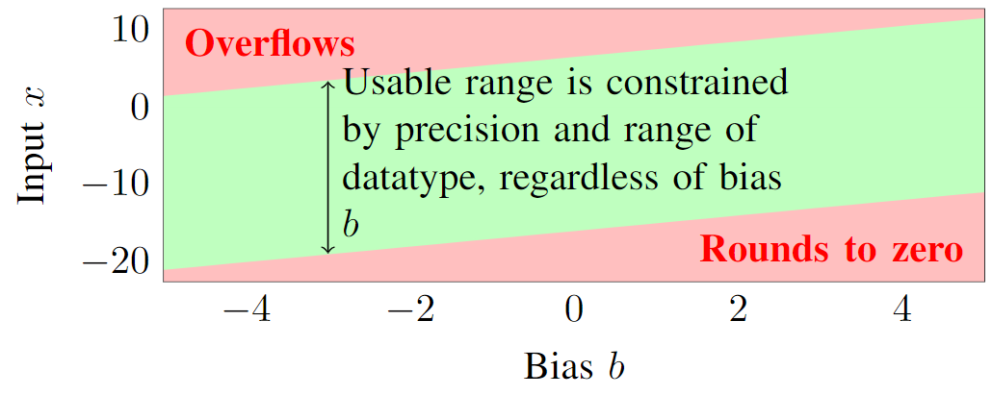
Approximation for Softmax
Challenge: deciding the shift value of b is not trivial
Question: there are multiple exp() in the denominator; shall we go through all of them to decide a single b?
Two-pass: first decide b, then calculate denominator

Slide 76
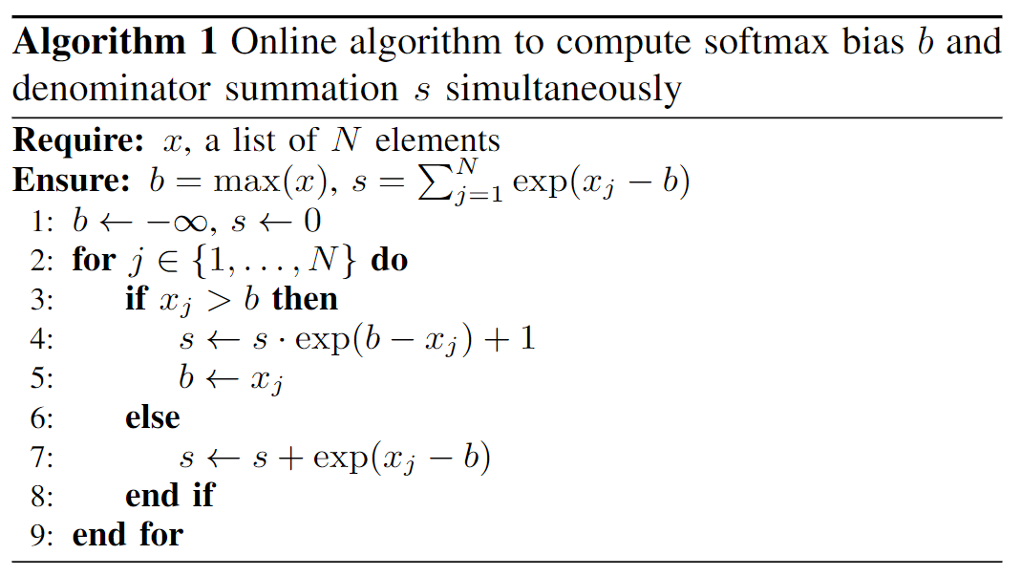
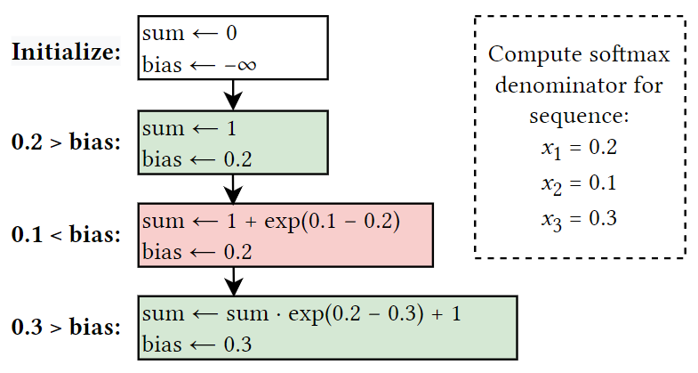
Approximation for Softmax
Two-pass: first decide b, then calculate denominator
One-pass is enough!

Slide 77
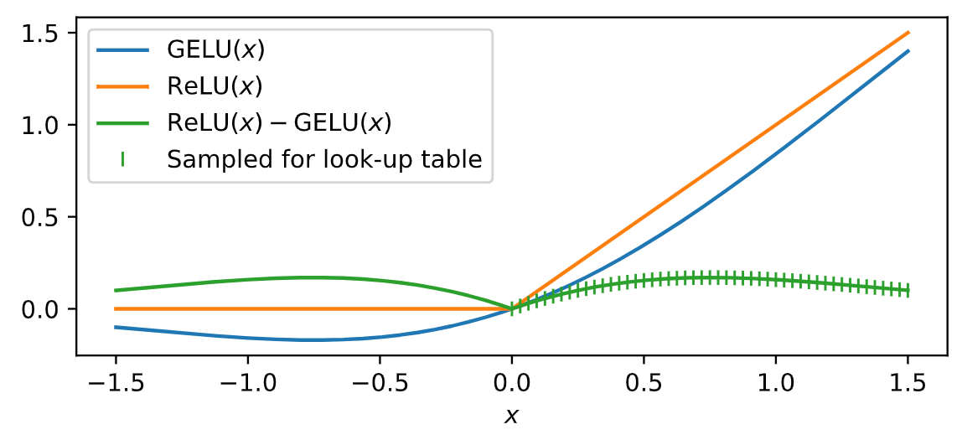
Approximation for GELU (Gaussian Error Linear Units)
Key idea: Use ReLU to compute GELU + delta
Difference between GELU and ReLU is symmetric about zero

Slide 78
M3ViT Evaluation on-FPGA
Measured on-FPGA (ZCU 102) with correct functionality: ~28.9 fps
Architecture | Latency (ms) (Speedup) | Hardware Resource |  |  |  | Sem. Seg. | Depth est. | Multi-task acc.
 |  | BRAM | DSP | LUT | FF | (mIoU↑) | (RMSE↓)
Baseline without proposed techniques | 650.3 (1.00x) | 84.6% | 65.9% | 60.8% | 46.9% | 63.81 | 0.0373 | +0.58%
+ Expert-by-expert reordering | 433.4 (1.5x) | 84.3% | 65.9% | 59.0% | 45.4% | 63.81 | 0.0373 | +0.58%
+Single-pass softmax with dynamic bias | 353.4 (1.84x) | 84.0% | 67.9% | 59.0% | 45.7% | 63.81 | 0.0373 | +0.58%
+Accurate, low-cost GELU | 212.9 (3.05x) | 64.1% | 63.0% | 45.5% | 34.9% | 63.84 | 0.0372 | +0.67%
+Unified linear layer module | 104.3 (6.23x) | 47.5% | 57.3% | 44.1% | 27.0% | 63.84 | 0.0372 | +0.67%
+Attention reordering | 34.6 (18.79x) | 48.1% | 61.6% | 46.5% | 27.5% | 63.84 | 0.0372 | +0.67%
Software baseline accuracy (PyTorch) |  |  |  |  |  | 63.95 | 0.0372 | +0.76%

Slide 79
M3ViT Evaluation on-FPGA
Up to 10× after optimizations
5.70× and 2.65× better energy efficiency than CPU and GPU
Generally applicable to transformers

Slide 80
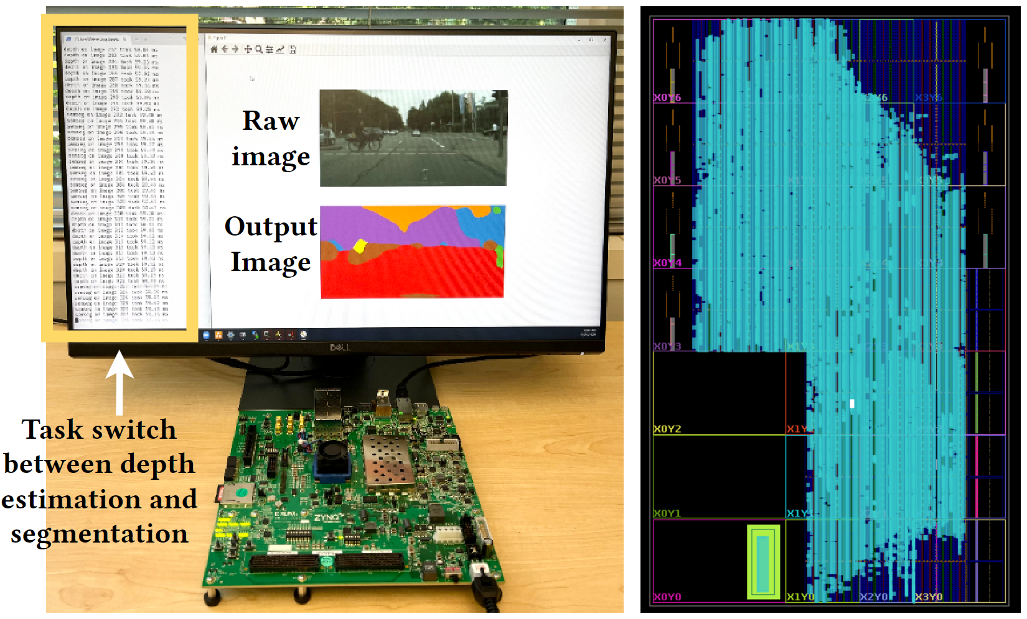
M3ViT : On-board Results

Slide 81
LightningSim – A fast and accurate HLS simulator
EDA Tools
Architectures
FlowGNN: A generic Graph Neural Network (GNN) accelerator on FPGA
GNNBuilder: An automated GNN accelerator generator
Edge-MoE: Multi-task Vision Transformer (HW)
LightningSim: Fast and Accurate Trace-Based Simulation for High-Level Synthesis
DGNN-Booster: A Generic FPGA Accelerator Framework For Dynamic Graph Neural Network Inference
INR-Arch: A Dataflow Architecture and Compiler for Arbitrary-Order Gradient Computations

Slide 82
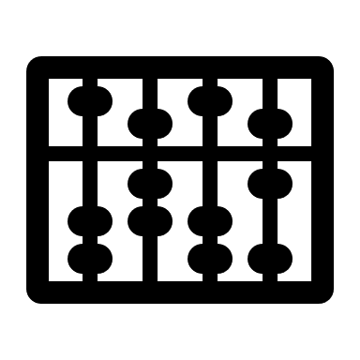
Simulation of HLS Designs
Speed
C Simulation
HLS Synthesis
C/RTL Co-sim
Accuracy

Slide 83
Simulation of HLS Designs
Speed
LightningSim
C Simulation
C/RTL Co-sim
Not a tradeoff but with advantages of both sides
Accuracy

Slide 84
What Can LightningSim Do?
C Simulation
C/RTL Co-sim
LightningSim
Speed | Fastest | Slowest | Fast
Cycle-level simulation | ✘ | ✔ | ✔
Functionality verification | C-level | RTL-level | C + LLVM-level
Incremental stall analysis | ✘ | ✘ | ✔
Suggest fastest FIFO depths | ✘ | ✘ | ✔

Slide 85
Prior Work
FLASH: Fast, Parallel, and Accurate Simulator for HLS
Choi et al. (TCAD 2020)
FastSim: A Fast Simulation Framework for High-Level Synthesis
Abderehman et al. (TCAD 2022)
HLS
Front-end
Compilation
LLVM IR
Bitcode
Scheduling and Binding
Static Timing Info.
RTL Generation
RTL
C/C++
code
C/RTL cosim
HLS synthesis
FastSim
Do we really need all these information to get started?
Starts after scheduling or RTL generation
Flash

Slide 86
Key Insights
A lot of information is already known at LLVM level
Xxxxx
We process these info first and then combine scheduling info later
HLS
Front-end
Compilation
LLVM IR
Bitcode
Scheduling and Binding
Static Timing Info.
RTL Generation
RTL
C/C++
code
C/RTL cosim
HLS synthesis
FastSim
Starts simultaneously with scheduling
No RTL code required
LightningSim
Flash

Slide 87
Our Approach
Map HLS scheduling information onto LLVM IR execution
Decoupled two steps:
LLVM IR execution trace generation
Trace analysis
1
2
HLS
Front-end
Compilation
LLVM IR
Bitcode
Scheduling and Binding
Static Timing Info.
RTL Generation
RTL
C/C++
code
C/RTL cosim
HLS synthesis
FastSim
Incremental simulation (e.g., stall and FIFO depth) without full simulation (as in co-sim)
LightningSim
1
2
Trace generation
Trace analysis
Flash

Slide 88
LightningSim Workflow
HLS Synthesis
LightningSim⚡
LLVM IR
❶
bitcode
IR Trace Generation
(A) Make LLVM IR executable
Static
scheduling
(B) Make LLVM IR traceable
information
Execute modified IR and dump a trace
Decoupled
Dumped Trace
two
❷
stages
IR Trace Analysis
(C) Trace parsing
(D) Resolving dynamic schedule
Change
Non-pipelined non-dataflow basic blocks
FIFO depth
Dataflow basic blocks
Re-compute stalls
(E) Calculating stalls
without re-simulating
(unlike current HLS
(F) Modeling AXI interfaces
or simulation tools)

Slide 89
LightningSim Workflow
HLS Synthesis
LightningSim⚡
LLVM IR
❶
bitcode
IR Trace Generation
(A) Make LLVM IR executable
Static
scheduling
(B) Make LLVM IR traceable
information
Execute modified IR and dump a trace
Decoupled
Dumped Trace
two
❷
stages
IR Trace Analysis
(C) Trace parsing
(D) Resolving dynamic schedule
Change
Non-pipelined non-dataflow basic blocks
FIFO depth
Dataflow basic blocks
Re-compute stalls
(E) Calculating stalls
without re-simulating
(unlike current HLS
(F) Modeling AXI interfaces
or simulation tools)

Slide 90
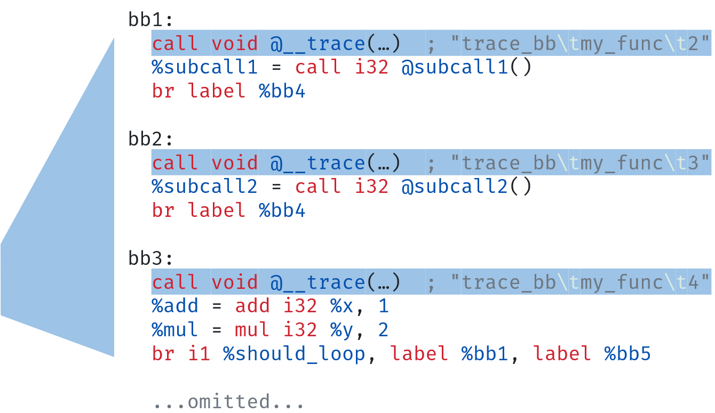
Trace Generation
HLS generated LLVM IR
(a) Generate undefined functions on-the-fly
(b) Insert helper code into IR for tracing
LightningSim modified LLVM IR
Trace of LLVM basic blocks
Compile and Run!
BB1
BB2
BB4
BB1
BB3
BB4
BB1
BB3
BB4
time

Slide 91
LightningSim Workflow
HLS Synthesis
LightningSim⚡
LLVM IR
❶
bitcode
IR Trace Generation
(A) Make LLVM IR executable
Static
scheduling
(B) Make LLVM IR traceable
information
Execute modified IR and dump a trace
Dumped Trace
❷
IR Trace Analysis
(C) Trace parsing
(D) Resolving dynamic schedule
Change
Non-pipelined non-dataflow basic blocks
FIFO depth
Dataflow basic blocks
Re-compute stalls
(E) Calculating stalls
without re-simulating
(unlike current HLS
(F) Modeling AXI interfaces
or simulation tools)

Slide 92
Trace Resolution
Examine the trace of basic blocks for each function call in the hierarchy
Map the HLS static scheduling data (FSM states) into a dynamic schedule
Static Stage
Static Stage
Instruction
1
2
3
4
5
1
2
3
4
1
5
3
4
BB1
fifo_read
br
BB2
subcall1
(D) Schedule
Basic Block
br
Resolution
BB3
subcall2
br
add
BB4
mul
br
1
2
3
4
5
6
7
8
Trace of LLVM basic blocks
Dynamic Stage
BB1
BB2
BB4
BB1
BB3
BB4
Time
Time

Slide 93
LightningSim Evaluation
99.9%-accurate on cycle counts comparing to C/RTL co-sim
100% accurate for 26 out of 33 cases
5.6–95.9× speedup over cosim (usually highest for larger designs)
For FlowGNN GIN, cosim takes 1h 10m; LightningSim takes 44 seconds
Finishes faster than HLS synthesis in 13 of 33 cases

Slide 94
Performance Results
LightningSim finishes
HLS Synthesis finishes
For many cases, LightningSim finishes earlier than HLS synthesis!

Slide 95
Our ROAD4NN – Future?
EDA Tools
Architectures
FlowGNN
GNNBuilder
Edge-MoE
LightningSim
DGNN-Booster
INR-Arch
The Best Way to Predict the Future is to Create it.
– P. Drucker & A. Lincoln

Slide 96
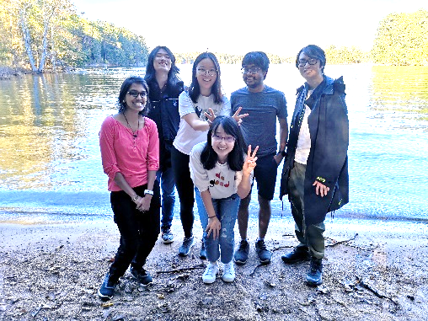
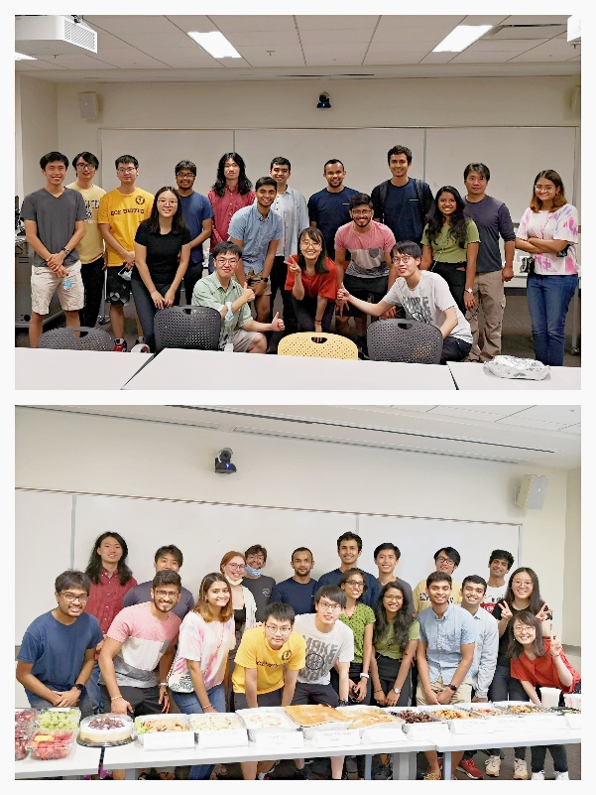
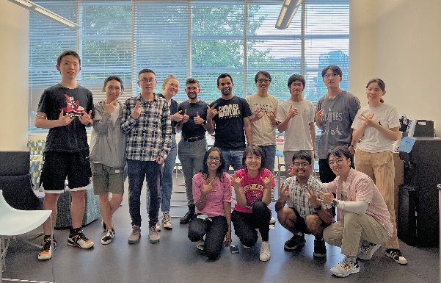
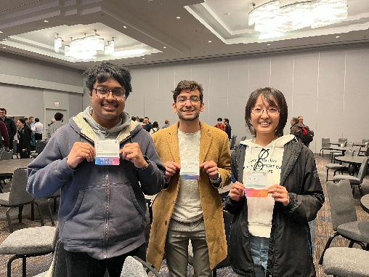
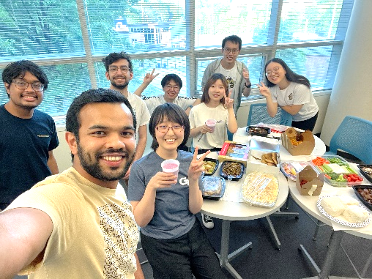
Contact
Software/Hardware Co-Design for Intelligence and Efficiency
Email: callie.hao@ece.gatech.edu
Homepage: http://sharclab.ece.gatech.edu

