Slide 1
Deep Neural Network and Accelerator Co-Design: Present and Future
Cong (Callie) Hao
Assistant Professor
Georgia Institute of Technology
School of Electrical and Computer Engineering
Sharc-lab @ Georgia Tech https://sharclab.ece.gatech.edu/

Slide 2
What is DNN and Accelerator Co-design?
Deep Neural Network (DNN) Design
Accelerator Design

Slide 3
What is DNN and Accelerator Co-design?
Deep Neural Network (DNN) Design
Accelerator Design
DNN Model
Deploy the model to the device

Slide 4
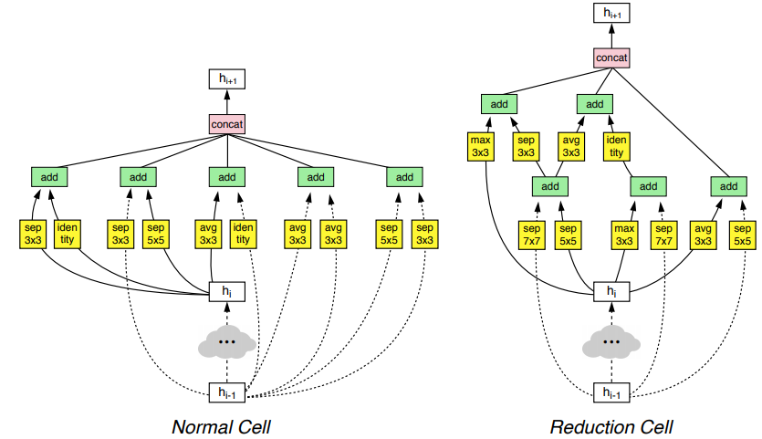
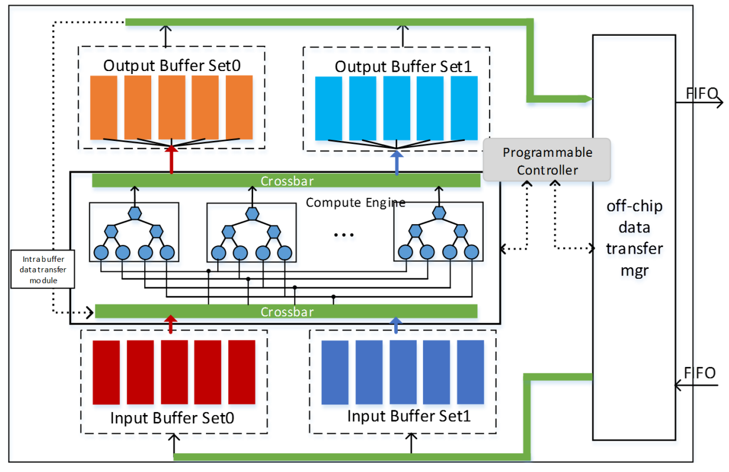
What is DNN and Accelerator Co-design?
Deep Neural Network (DNN) Design
Accelerator Design
An automatic neural architecture search (NAS) methodology – a.k.a. AutoML
Boosts the quality and accuracy of machine learning algorithms
On GPU/TPU/NPU: optimized (tuned) neural network implementations
On FPGA: customized DNN accelerators
Zoph, Barret, et at. "Learning transferable architectures for scalable image recognition." CVPR 2018
Chen Zhang, et al. “Optimizing fpga-based accelerator design for deep convolutional neural networks”, FPGA 2015

Slide 5
What is DNN and Accelerator Co-design?
Deep Neural Network (DNN) Design
Accelerator Design
An automatic neural architecture search (NAS) methodology – a.k.a. AutoML
Boosts the quality and accuracy of machine learning algorithms
On GPU/TPU/NPU: optimized (tuned) neural network implementations
On FPGA: customized DNN accelerators
Zoph, Barret, et at. "Learning transferable architectures for scalable image recognition." CVPR 2018
Chen Zhang, et al. “Optimizing fpga-based accelerator design for deep convolutional neural networks”, FPGA 2015

Slide 6
Three Levels of Co-Design in Cake Factory…
Bake a cake…
Build a plate…
Oops cake too big
Level 0

Slide 7
Three Levels of Co-Design in Cake Factory…
Bake a cake…
Build a plate…
Oops cake too big
Level 0
Plate is different from expected…
Level 1

Slide 8
Three Levels of Co-Design in Cake Factory…
Bake a cake…
Build a plate…
Oops cake too big
Level 0
Plate is different from expected…
Level 1
Level 2
Bake&build in pairs!

Slide 9
Three Levels of Co-Design for DNN/Accelerator
Deep Neural Network (DNN) Design
Accelerator Design
Neural Architecture Search (NAS)
Accelerator Design
Level 0
Pure NAS

Slide 10
Three Levels of Co-Design for DNN/Accelerator
Deep Neural Network (DNN) Design
Accelerator Design
Neural Architecture Search (NAS)
Accelerator Design
Level 0
Pure NAS
Searched DNN
NAS with HW cost
Accelerator Evaluation
Accelerator Design
Level 1
Hardware-aware NAS

Slide 11
Three Levels of Co-Design for DNN/Accelerator
Deep Neural Network (DNN) Design
Accelerator Design
Neural Architecture Search (NAS)
Accelerator Design
Level 0
Pure NAS
Searched DNN
NAS with HW cost
Accelerator Evaluation
Accelerator Design
Level 1
Hardware-aware NAS
DNN and Accelerator Co-Design
Searched DNN + Accelerator
Level 2
Accelerator Fine-tune
[ ]
[ ]
[ ]
True DNN and Accelerator Co-Design

Slide 12
Three Levels of Co-Design for DNN/Accelerator
Deep Neural Network (DNN) Design
Accelerator Design
Searched DNN
NAS with HW cost
Accelerator Evaluation
Accelerator Design
Level 1
Hardware-aware NAS
DNN and Accelerator Co-Design
Searched DNN + Accelerator
Level 2
Accelerator Fine-tune
[ ]
[ ]
[ ]
True DNN and Accelerator Co-Design

Slide 13
Three Levels of Co-Design for DNN/Accelerator
Deep Neural Network (DNN) Design
Accelerator Design
Fixed Accelerator
Searched DNN
NAS with HW cost
Accelerator Evaluation
Accelerator Design
Level 1
Hardware-aware NAS
Accelerator design can also change
DNN and Accelerator Co-Design
Searched DNN + Accelerator
Level 2
Accelerator Fine-tune
[ ]
[ ]
[ ]
True DNN and Accelerator Co-Design

Slide 14
Level 2 Co-Design for DNN/Accelerator
Our major focus
Accelerator design can also change
DNN and Accelerator Co-Design
Searched DNN + Accelerator
Level 2
Accelerator Fine-tune
[ ]
[ ]
[ ]
True DNN and Accelerator Co-Design

Slide 15
Level 2 Co-Design for DNN/Accelerator
Software: Neural Architecture Search (NAS)
Our major focus
Hardware: Implementation Search
Accelerator design can also change
DNN and Accelerator Co-Design
Searched DNN + Accelerator
Level 2
Accelerator Fine-tune
[ ]
[ ]
[ ]
True DNN and Accelerator Co-Design

Slide 16
Level 2 Co-Design for DNN/Accelerator
Software: Neural Architecture Search (NAS)
Our major focus
Hardware: Implementation Search
=
NAIS
Accelerator design can also change
DNN and Accelerator Co-Design
Searched DNN + Accelerator
Level 2
Accelerator Fine-tune
[ ]
[ ]
[ ]
True DNN and Accelerator Co-Design

Slide 17
Why Co-Design?
Independent NAS and Implementation search
Long iterative procedure: time consuming
Hardware-unfriendly DNN models: sub-optimal solutions
Application, QoS & QoR Target, etc.
1. Software: DNN Model Search (NAS)
Well designed DNN model
2. Hardware: Implementation Search
Deployment
Independent NAS and implementation search

Slide 18
NAIS: Simultaneous NAS + Implementation
Simultaneous NAS and Implementation search
DNN 1
DNN 2
…
DNN n
NAIS Engine
IMP 1
IMP 2
…
IMP n
Solution Pair 1
Solution Pair 2
Solution Pair 3

Slide 19
NAIS: Simultaneous NAS + Implementation
Simultaneous NAS and Implementation search
DNN 1
DNN 2
…
DNN n
NAIS Engine
IMP 1
IMP 2
…
IMP n
Solution Pair 1
Solution Pair 2
Solution Pair 3
“One-click AI"
Automated AI algorithm development and deployment
“Good AI”
Bridge the gap between SW/HW for higher quality solutions

Slide 20
Key Methodologies for Co-Design
Software:
Neural Architecture Search Space
Hardware:
Implementation Search Space

Slide 21
Key Methodologies for Co-Design
Software:
Neural Architecture Search Space
Hardware:
Implementation Search Space
1
Method 1: find something in the middle and connect to both SW and HW
FPGA/DNN Co-Design [DAC’19, SysML’20]

Slide 22
Key Methodologies for Co-Design
Software:
Neural Architecture Search Space
Hardware:
Implementation Search Space
1
Method 1: find something in the middle and connect to both SW and HW
FPGA/DNN Co-Design [DAC’19, SysML’20]
2
Method 2: merge the two spaces – formulate both in one equation
A True NAIS work
EDD [ICCAD’19, DAC’20]

Slide 23
Key Methodologies for Co-Design
Software:
Neural Architecture Search Space
Hardware:
Implementation Search Space
1
Method 1: find something in the middle and connect to both SW and HW
FPGA/DNN Co-Design [DAC’19, SysML’20]
Hao, Cong, Xiaofan Zhang, Yuhong Li, Sitao Huang, Jinjun Xiong, Kyle Rupnow, Wen-mei Hwu, and Deming Chen. "FPGA/DNN co-design: An efficient design methodology for IoT intelligence on the edge." ACM/IEEE DAC, 2019. (seems to be most cited in DAC 2019)

Slide 24
FPGA/DNN Co-Design
DNNs
Accelerators (FPGA)

Slide 25
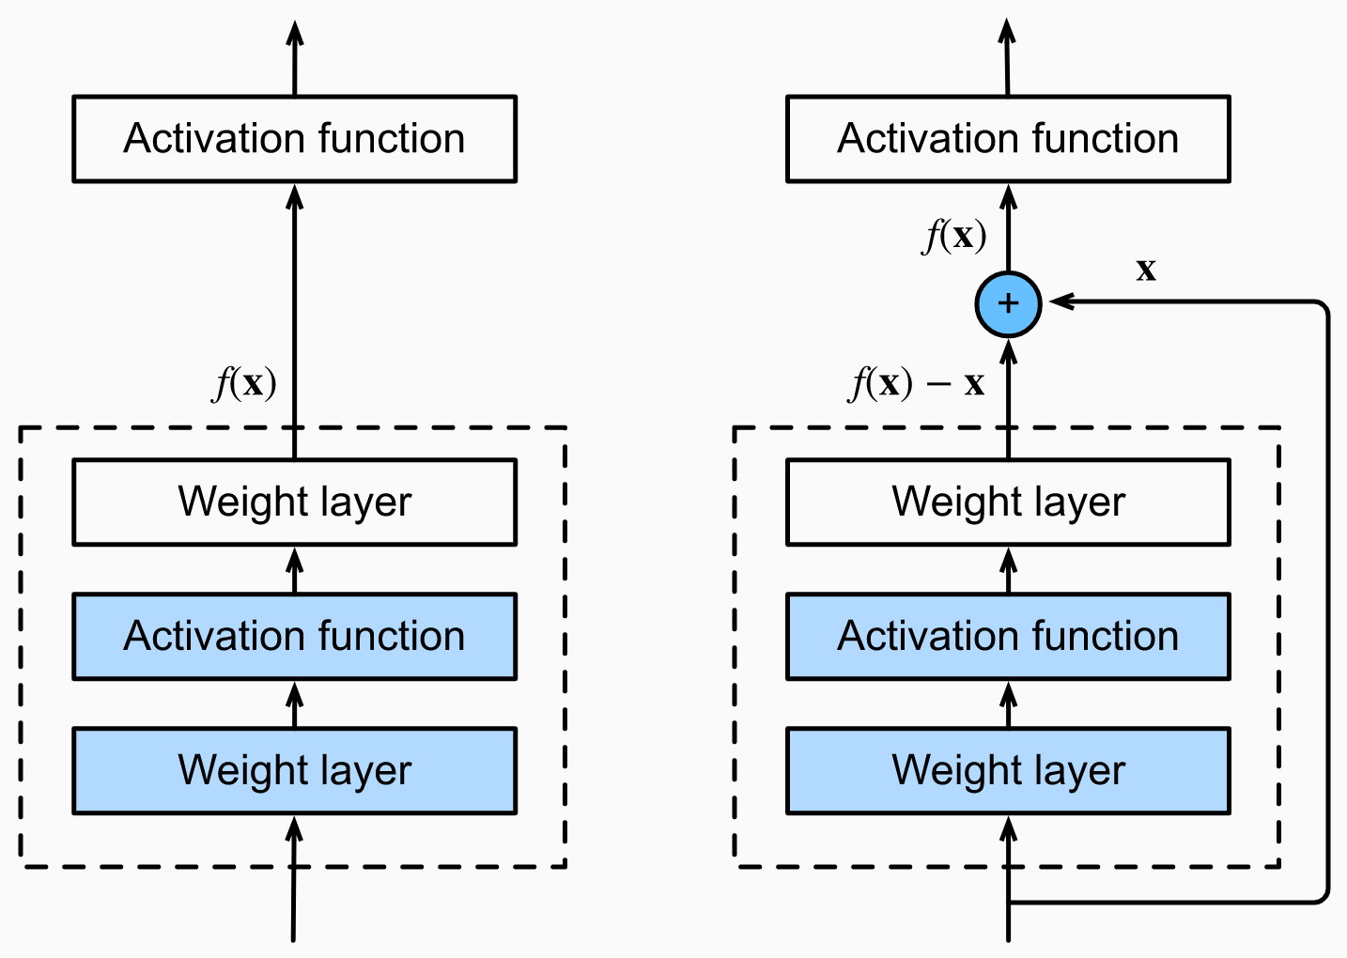
FPGA/DNN Co-Design
DNNs are usually built by repeated or similar basic blocks
Accelerators (FPGA)
https://d2l.ai/chapter_convolutional-modern/resnet.html

Slide 26
FPGA/DNN Co-Design
DNNs are usually built by repeated or similar basic blocks
Accelerators (FPGA) are usually built by Processing Elements (PE)
Convolution
1x1
Relu
Convolution
3x3
Depth-wise Convolution
3x3
Pooling
https://d2l.ai/chapter_convolutional-modern/resnet.html

Slide 27
FPGA/DNN Co-Design
DNNs are usually built by repeated or similar basic blocks
Accelerators (FPGA) are usually built by Processing Elements (PE)
PE implements basic blocks
– “something in the middle” we are looking for
Convolution
1x1
Relu
Convolution
3x3
Depth-wise Convolution
3x3
Pooling
https://d2l.ai/chapter_convolutional-modern/resnet.html

Slide 28
FPGA/DNN Co-Design
Software
DNN
determines
Basic Building Block
determines
FPGA
Hardware

Slide 29
FPGA/DNN Co-Design
Input
Software
Conv 3x3
1st Basic Block
DNN
DW-Conv 3x3
2nd Basic Block
Conv 1x1
3rd Basic Block
…
Activation
Conv 3x3
Output
DW-Conv 3x3
Conv 1x1
Activation
FPGA
Hardware

Slide 30
FPGA/DNN Co-Design
Input
Software
Conv 3x3
1st Basic Block
DNN
DW-Conv 3x3
2nd Basic Block
Conv 1x1
3rd Basic Block
…
Activation
Conv 3x3
Output
DW-Conv 3x3
Implements
Conv 1x1
Activation
Convolution
1x1
Relu
Convolution
3x3
FPGA
Depth-wise Convolution 3x3
Hardware
Pooling

Slide 31
FPGA/DNN Co-Design
Software
DNN
Conv 3x3
How to choose these basic building blocks from a large design space?
DW-Conv 3x3
Conv 1x1
Activation
FPGA
Hardware

Slide 32
DNN/FPGA Co-Design Flow
Target ML task; FPGA device (resources); performance targets (QoS)
Auto-DNN: Co-Search Engine
Step 1. Basic building block modeling
Step 2. Building block selection
Auto-HLS:
FPGA Accelerator Generator
Step 3. DNN search and update
Software: DNN Model
Hardware: FPGA Accelerator

Slide 33
DNN/FPGA Co-Design Flow
Target ML task; FPGA device (resources); performance targets (QoS)
Input feature maps:
8x8 tiling
IP outputs
1
2
3
4
Off-chip data transfer
Auto-DNN: Co-Search Engine
Load data
1
2
3
4
Time
CONV 3x3
1
2
3
4
CONV 1x1
1
2
3
4
Step 1. Basic building block modeling
1
2
3
4
Pooling
Write back
1
2
3
4
Accelerator template
Step 2. Building block selection
Auto-HLS:
FPGA Accelerator Generator
Step 3. DNN search and update
Software: DNN Model
Hardware: FPGA Accelerator

Slide 34
DNN/FPGA Co-Design Flow
Auto-DNN: Co-Search Engine
Step 1. Basic building block modeling
Step 2. Building block selection
Auto-HLS:
FPGA Accelerator Generator
Step 3. DNN search and update
Software: DNN Model
Hardware: FPGA Accelerator

Slide 35
DNN/FPGA Co-Design Flow
Auto-DNN: Co-Search Engine
Job interview…
Step 1. Basic building block modeling
CV screening
Step 2. Building block selection
Phone Interview
Auto-HLS:
FPGA Accelerator Generator
Step 3. DNN search and update
Onsite Interview
Software: DNN Model
Hardware: FPGA Accelerator

Slide 36
DNN/FPGA Co-Design Flow
Auto-DNN: Co-Search Engine
To provide performance estimation of a DNN
Step 1. Basic building block modeling
Step 2. Building block selection
$$Res_{bund_{i}}^{r} =\sum_{p_{j}}{Res_{j}^{r}} +Γ_{i}^{r}$$
Auto-HLS:
FPGA Accelerator Generator
$$La{t_{bund}}_{i}=α_{i} ⋅\sum_{p_{j}}{Comp_{j}}+\frac{β_{i}⋅Θ(Data_{i})}{bw}$$
Step 3. DNN search and update
$$Res_{DNN}=Re{s_{bund}}_{i}+γ⋅Res_{ctl}$$
$$Lat_{DNN}=\sum_{i=1}^{N}{Lat_{bund}} +φ⋅Lat_{DM}$$
Software: DNN Model
Hardware: FPGA Accelerator

Slide 37
DNN/FPGA Co-Design Flow
Auto-DNN: Co-Search Engine
Step 1. Basic building block modeling
Only Keep promising ones to reduces design space
Step 2. Building block selection
Auto-HLS:
FPGA Accelerator Generator
Step 3. DNN search and update
Software: DNN Model
Hardware: FPGA Accelerator

Slide 38
DNN/FPGA Co-Design Flow
0.57
Building Blocks
Auto-DNN: Co-Search Engine
0.56
Accuracy (IoU)
0.55
Step 1. Basic building block modeling
Pareto Curves
0.54
Only Keep promising ones to reduces design space
0.53
Step 2. Building block selection
Auto-HLS:
FPGA Accelerator Generator
0.52
PF=8
PF=4
PF=16
Step 3. DNN search and update
0.51
Software: DNN Model
Hardware: FPGA Accelerator

Slide 39
DNN/FPGA Co-Design Flow
Auto-DNN: Co-Search Engine
Step 1. Basic building block modeling
Step 2. Building block selection
Auto-HLS:
FPGA Accelerator Generator
Perturb, train, and select DNNs within performance constraint
Step 3. DNN search and update
Software: DNN Model
Hardware: FPGA Accelerator

Slide 40
NAIS Victory – DAC System Design Contest
Design Automation Conference System Design Contest (DAC-SDC)
Object detection on FPGA/GPU
Our Achievements
2018: Third place @ FPGA (3 out of 51)

Slide 41
NAIS Victory – DAC System Design Contest
Design Automation Conference System Design Contest (DAC-SDC)
Object detection on FPGA/GPU
Our Achievements
2018: Third place @ FPGA (3 out of 51)
Independently designed DNN and FPGA accelerator – a lot of iterations!

Slide 42
NAIS Victory – DAC System Design Contest
Design Automation Conference System Design Contest (DAC-SDC)
Object detection on FPGA/GPU
Our Achievements
2018: Third place @ FPGA (3 out of 51)
2019: Double championship @ FPGA and GPU (1 out of 58, 1 out of 56)
Independently designed DNN and FPGA accelerator – a lot of iterations!

Slide 43
NAIS Victory – DAC System Design Contest
Design Automation Conference System Design Contest (DAC-SDC)
Object detection on FPGA/GPU
Our Achievements
2018: Third place @ FPGA (3 out of 51)
2019: Double championship @ FPGA and GPU (1 out of 58, 1 out of 56)
Independently designed DNN and FPGA accelerator – a lot of iterations!
NAIS co-design leads to victory!

Slide 44
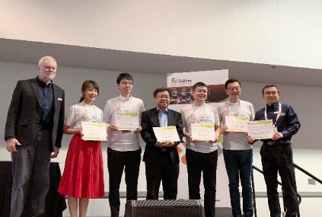
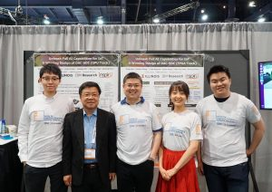
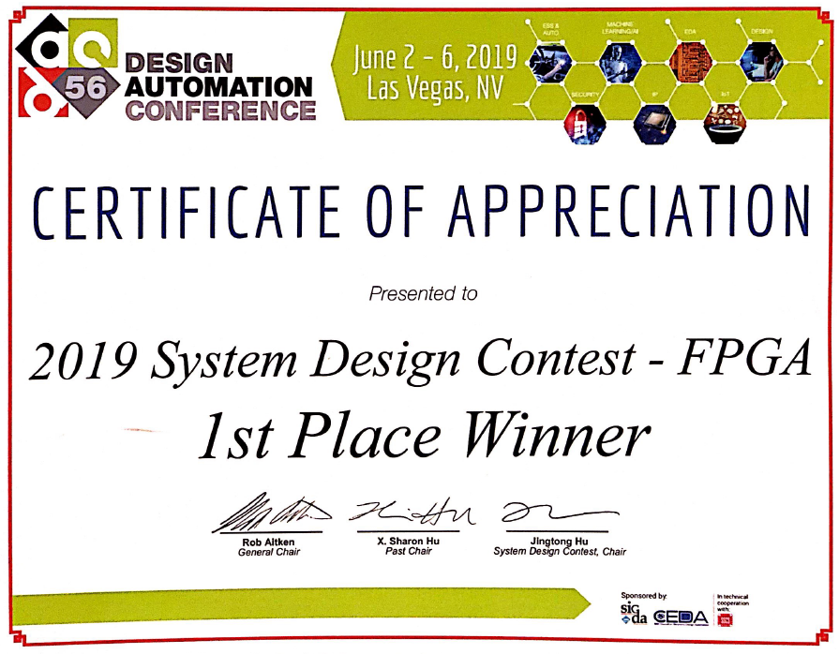
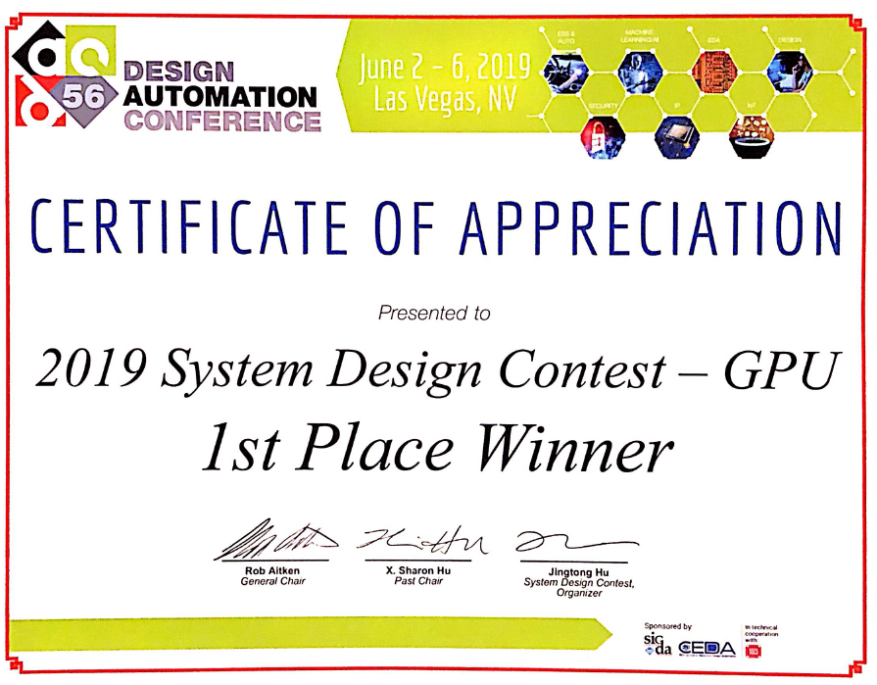
NAIS Victory – DAC System Design Contest
Media coverage and open-source code
https://www.ibm.com/blogs/research/2019/06/winning-ai-algorithms-drones/
2018: https://github.com/onioncc/iSmartDNN
2019: https://github.com/TomG008/SkyNet
2020: https://github.com/jgoeders/dac_sdc_2020_designs

Slide 45
Key Methodologies for Co-Design
Software:
Neural Architecture Search Space
Hardware:
Implementation Search Space
1
Method 1: find something in the middle and connect to both SW and HW
FPGA/DNN Co-Design [DAC’19, SysML’20]

Slide 46
Key Methodologies for Co-Design
Software:
Neural Architecture Search Space
Hardware:
Implementation Search Space
Li, Yuhong, Cong Hao, Xiaofan Zhang, Xinheng Liu, Yao Chen, Jinjun Xiong, Wen-mei Hwu, and Deming Chen. "EDD: Efficient differentiable DNN architecture and implementation co-search for embedded AI solutions." DAC 2020
2
Method 2: merge the two spaces – formulate both in one equation
A True NAIS work
EDD [ICCAD’19, DAC’20]

Slide 47
Key Methodologies for Co-Design
Software:
Neural Architecture Search Space
Hardware:
Implementation Search Space
{A}
{I}
Put {A, I} into one formulation, preferably differentiable
Solve {A, I} using continuous optimization, e.g., Gradient Descent
2
Method 2: merge the two spaces – formulate both in one equation
A True NAIS work
EDD [ICCAD’19, DAC’20]

Slide 48
NAIS Formulation
Existing Formulation
$$min: ℒ= Acc_{loss}\left(A\right)⋅Perf_{loss}(I_{0})$$
$A$ is differentiable with respect to $ℒ$
Implementation $I_{0}$ is fixed (not in the search space)
Hardware-ware NAS
NAIS Formulation
$$min: ℒ= Acc_{loss}\left(A, I\right)⋅Perf_{loss}\left(I\right)+β⋅C^{RES\left(I\right)−RES_{ub}}$$
True co-design
$A$ is differentiable with respect to $ℒ$
Implementation $I$ is also variable
Consider resource constraints

Slide 49
NAIS Formulation
Existing Formulation
$$min: ℒ= Acc_{loss}\left(A\right)⋅Perf_{loss}(I_{0})$$
$A$ is differentiable with respect to $ℒ$
Implementation $I_{0}$ is fixed (not in the search space)
Hardware-ware NAS
NAIS Formulation
$$min: ℒ= Acc_{loss}\left(A, I\right)⋅Perf_{loss}\left(I\right)+β⋅C^{RES\left(I\right)−RES_{ub}}$$
True co-design
$A$ is differentiable with respect to $ℒ$
Implementation $I$ is also variable
Consider resource constraints
Challenge
How to formulate $I$ as differentiable with respect to $ℒ$?

Slide 50
Differentiable DNN Architecture Search
Neural Architecture Search (NAS)
DNN
Candidate operations of $block_{i}$
One candidate operation ${op}_{i}^{m}$
$$Input_{i}$$
$$Input_{i}$$
…
$Conv$ $1×1$
$$block_{i}$$
…
…
$$op_{i}^{1}$$
$${op}_{i}^{2}$$
$${op}_{i}^{m}$$
$dw$-$conv k×k$
…
$Conv$ $1×1$
$$Output_{i}$$
$$Output_{i}$$

Slide 51
Differentiable DNN Architecture Search
Neural Architecture Search (NAS)
DNN
Candidate operations of $block_{i}$
One candidate operation ${op}_{i}^{m}$
$$Input_{i}$$
$$Input_{i}$$
…
Discrete solution space
$Conv$ $1×1$
$$block_{i}$$
…
…
$$op_{i}^{1}$$
$${op}_{i}^{2}$$
$${op}_{i}^{m}$$
$dw$-$conv k×k$
…
$Conv$ $1×1$
$$Output_{i}$$
$$Output_{i}$$

Slide 52
Differentiable DNN Architecture Search
Neural Architecture Search (NAS)
DNN
Candidate operations of $block_{i}$
One candidate operation ${op}_{i}^{m}$
From discrete to continuous for differentiable:
Gumbel-Softmax
$$Input_{i}$$
$$Input_{i}$$
…
$$θ_{i,1}$$
$$θ_{i,2}$$
$$θ_{i,m}$$
Sampling parameter $θi,m$
Operations sampled following Gumbel-Softmax distribution
$θi,m$ is differentiable with respect to $ℒ$
$Conv$ $1×1$
$$block_{i}$$
…
…
$$op_{i}^{1}$$
$${op}_{i}^{2}$$
$${op}_{i}^{m}$$
$dw$-$conv k×k$
…
$Conv$ $1×1$
$$Output_{i}$$
$$Output_{i}$$

Slide 53
Differentiable Implementation Search
NAS
Implementation Search
One candidate operation ${op}_{i}^{m}$
Quantization of $op_{i}^{m}$
$$Input_{i}$$
$$Input_{i}$$
$Conv$ $1×1$
$dw$-$conv k×k$
…
$q_{1}$
$$q_{2}$$
-bit
-bit
-bit
$$q_{Q}$$
$Conv$ $1×1$
$$Output_{i}$$
$$Input_{i}$$

Slide 54
Differentiable Implementation Search
NAS
Implementation Search
One candidate operation ${op}_{i}^{m}$
Quantization of $op_{i}^{m}$
$$Input_{i}$$
$$Input_{i}$$
Similar technique:
Gumbel-Softmax
$Conv$ $1×1$
$$φ_{i,m,1}$$
$$φ_{i,m,2}$$
$$φ_{i,m,Q}$$
$dw$-$conv k×k$
…
$q_{1}$
$$q_{2}$$
-bit
-bit
-bit
$$q_{Q}$$
$Conv$ $1×1$
$$Output_{i}$$
$$Input_{i}$$

Slide 55
Differentiable Implementation Search
NAS
Implementation Search
One candidate operation ${op}_{i}^{m}$
Quantization of $op_{i}^{m}$
$$Input_{i}$$
$$Input_{i}$$
Similar technique:
Gumbel-Softmax
$Conv$ $1×1$
$$φ_{i,m,1}$$
$$φ_{i,m,2}$$
$$φ_{i,m,Q}$$
$I_{i}^{m}$: other implementation variables
$dw$-$conv k×k$
…
$q_{1}$
$$q_{2}$$
-bit
-bit
-bit
$$q_{Q}$$
$Conv$ $1×1$
$Pe{rf}^{q}\left(op_{i}^{m}\right)=f(I_{i}^{m})$
$Res^{q}\left(op_{i}^{m}\right)=g(I_{i}^{m})$
$$Output_{i}$$
$$Input_{i}$$

Slide 56
Now Since Everything is Differentiable…
NAS
Implementation Search
Differentiable
Differentiable
One candidate operation ${op}_{i}^{m}$
Quantization of $op_{i}^{m}$
$$min: ℒ= Acc_{loss}\left(A, I\right)⋅Perf_{loss}\left(I\right)+β⋅C^{RES\left(I\right)−RES_{ub}}$$
$$Input_{i}$$
$$Input_{i}$$
Similar technique:
Gumbel-Softmax
Continuous Optimization: gradient descent
$Conv$ $1×1$
$$φ_{i,m,1}$$
$$φ_{i,m,2}$$
$$φ_{i,m,Q}$$
$I_{i}^{m}$: other implementation variables
$dw$-$conv k×k$
…
$q_{1}$
$$q_{2}$$
-bit
-bit
-bit
$$q_{Q}$$
$Conv$ $1×1$
$Pe{rf}^{q}\left(op_{i}^{m}\right)=f(I_{i}^{m})$
$Res^{q}\left(op_{i}^{m}\right)=g(I_{i}^{m})$
$$Output_{i}$$
$$Input_{i}$$

Slide 57
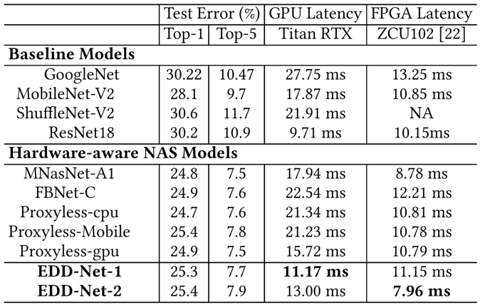
Comparisons with hardware-aware NAS
GPU-oriented DNN
FPGA-oriented DNN

Slide 58
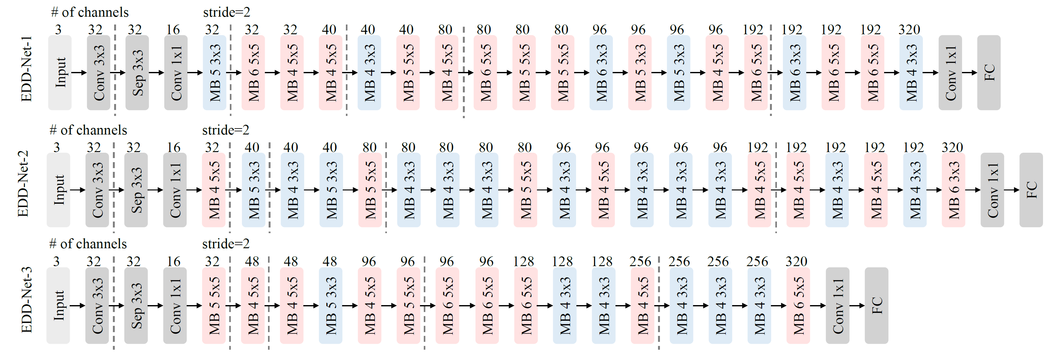
Comparisons with hardware-aware NAS
EDD-Net-1: targets GPU
EDD-Net-2: targets recursive FPGA accelerator
EDD-Net-3: targets pipelined FPGA accelerator

Slide 59
Follow-up Works using Differentiable Approach

Slide 60
What’s NAIS’s Next?
Software: Neural Architecture Search (NAS)
Hardware: Implementation Search
=
NAIS

Slide 61
What’s NAIS’s Next?
Software: Neural Architecture Search (NAS)
Hardware: Implementation Search
=
NAIS

Slide 62
What’s NAIS’s Next?
Software: Neural Architecture Search (NAS)
Hardware: Implementation Search
=
Multi-modal Multi-task Models
NAIS

Slide 63
What’s NAIS’s Next?
Software: Neural Architecture Search (NAS)
Hardware: Implementation Search
=
Multi-modal Multi-task Models
NAIS
Heterogeneous Platform Mapping-aware NAIS

Slide 64
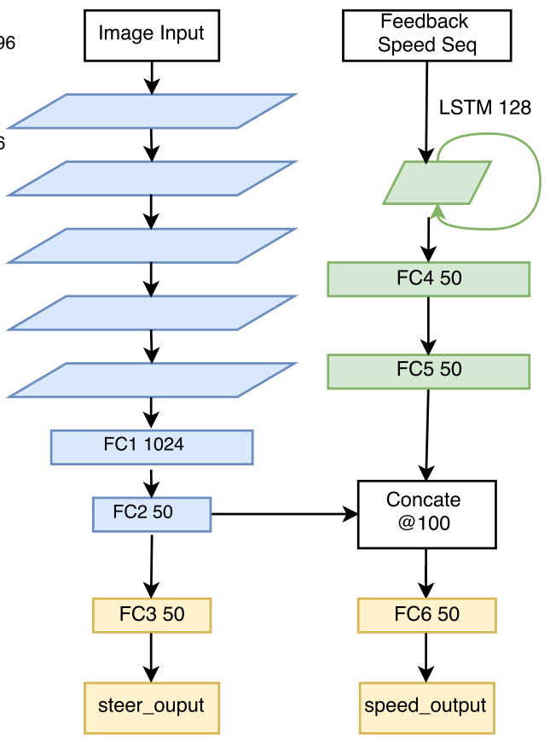
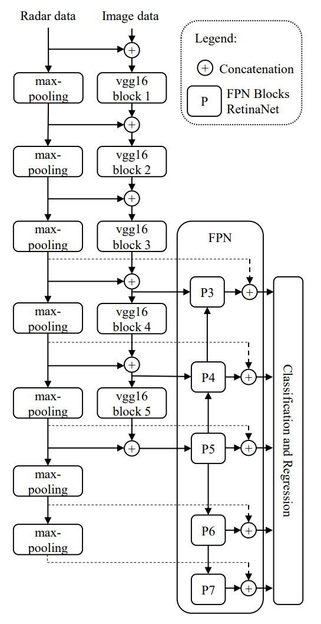
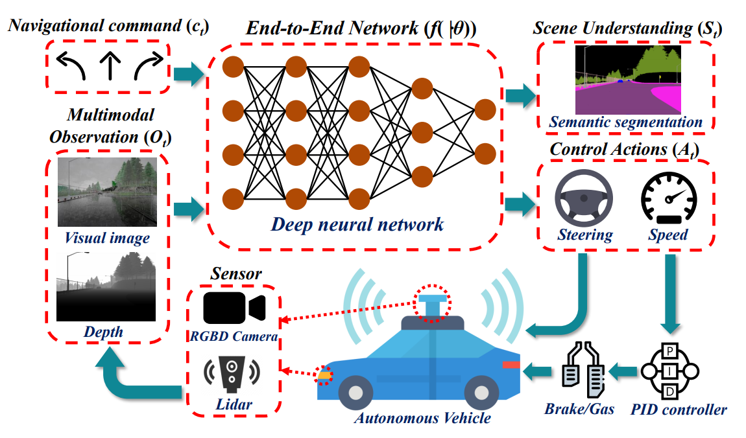
Multi-modal Multi-Task Models (MMMT)
Multi-modal: process and relate information from multiple modalities
Text: natural language
Visual: images or videos
Vocal: sounds
Point clouds, sensor data (accelerometer, speed), etc.
Yang, Zhengyuan, et al. "End-to-end multi-modal multi-task vehicle control for self-driving cars with visual perceptions." 2018 24th International Conference on Pattern Recognition (ICPR). IEEE, 2018.
Nobis, Felix, et al. "A deep learning-based radar and camera sensor fusion architecture for object detection." 2019 Sensor Data Fusion: Trends, Solutions, Applications (SDF). IEEE, 2019.
Huang Z, et al. Multi-modal sensor fusion-based deep neural network for end-to-end autonomous driving with scene understanding. IEEE Sensors Journal. 2020 Jun 17.

Slide 65
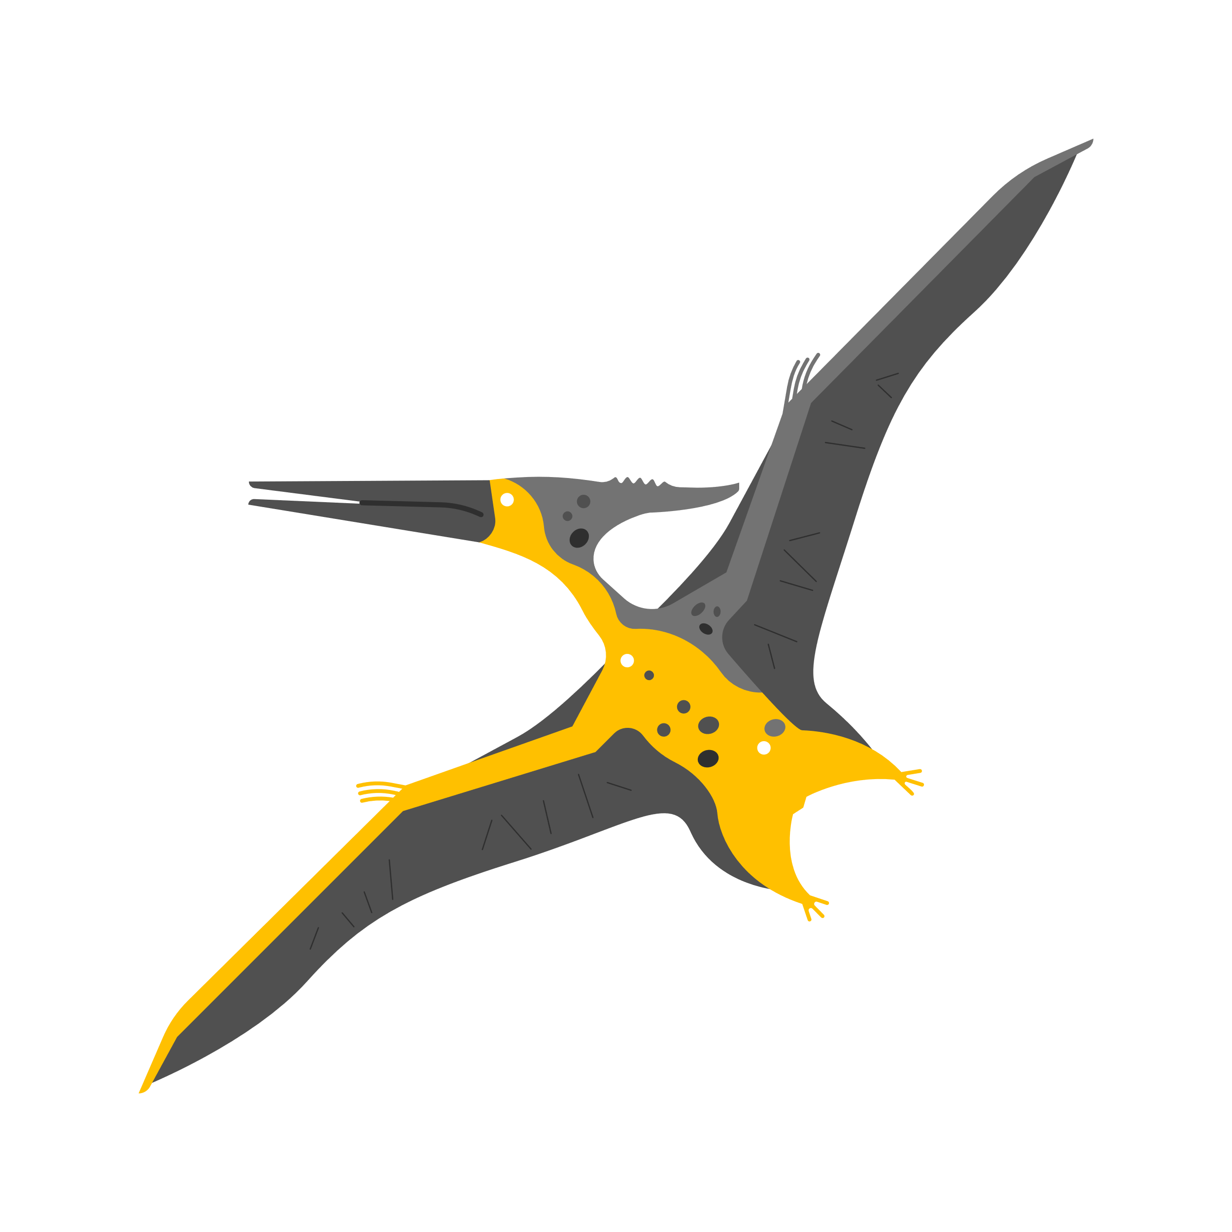
Multi-modal Multi-Task Models (MMMT)
Multi-modal: process and relate information from multiple modalities
Text, visual, vocal, motion, etc.
Sound
Image
Motion

Slide 66
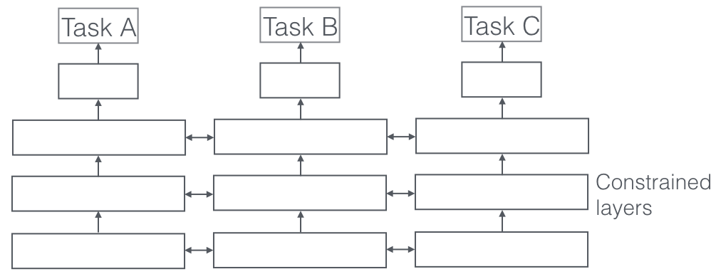
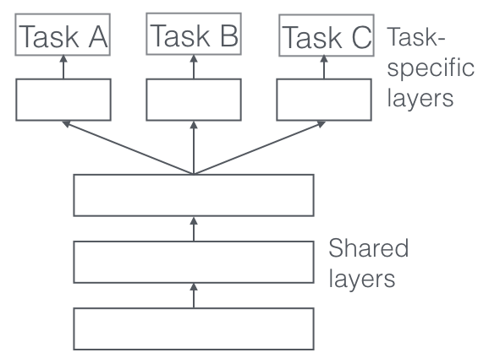
Multi-modal Multi-Task Models (MMMT)
Multi-modal: process and relate information from multiple modalities
Text, visual, vocal, motion, etc.
Multi-task: to learn multiple related tasks jointly
Knowledge transfer
Improve the generalization performance
Mitigate training (labeled) data sparsity
Ruder, Sebastian. "An overview of multi-task learning in deep neural networks." arXiv preprint arXiv:1706.05098 (2017).

Slide 67
Multi-modal Multi-Task Models (MMMT)
Multi-modal: process and relate information from multiple modalities
Text, visual, vocal, motion, etc.
Multi-task: to learn multiple related tasks jointly
Knowledge transfer
Improve the generalization performance
Mitigate training (labeled) data sparsity
Largely increased complexity in model structure

Slide 68
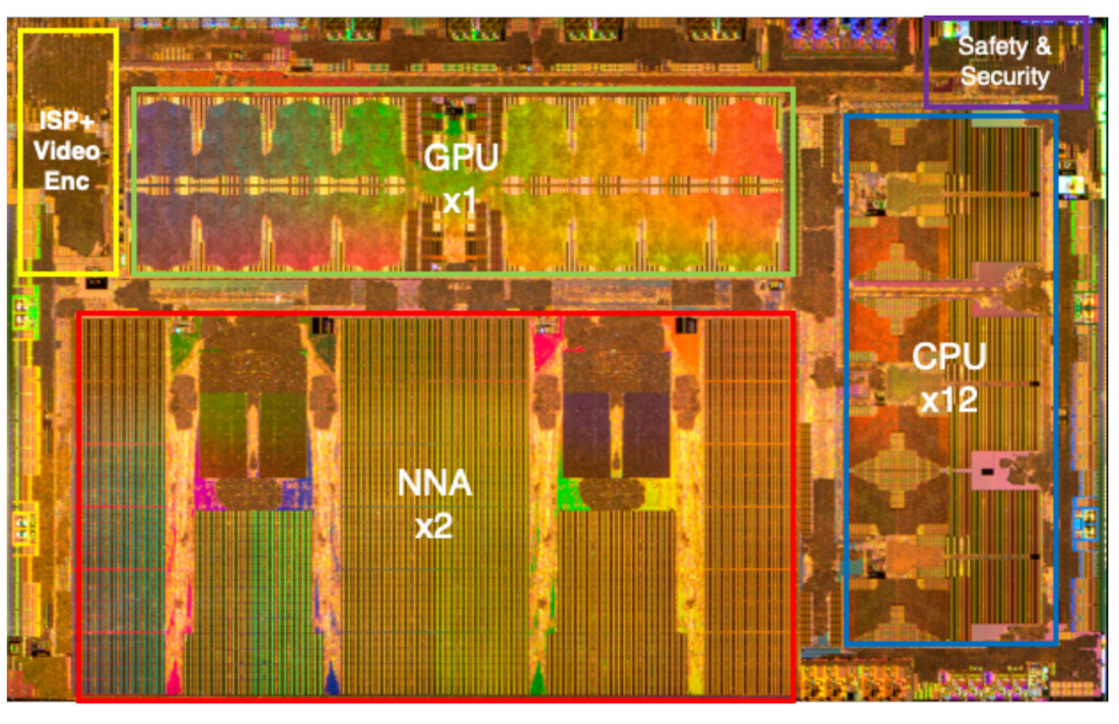
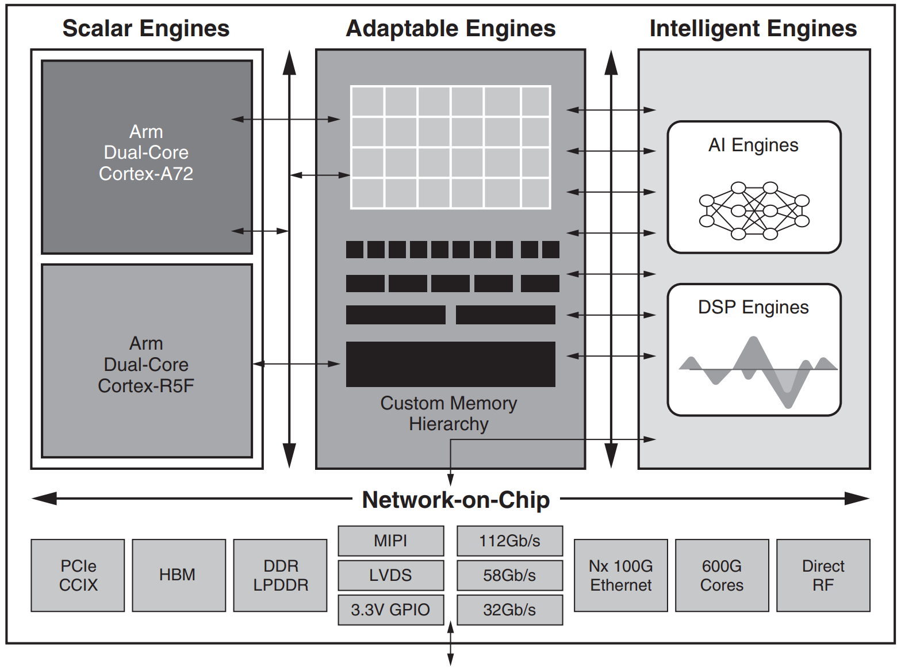
Heterogeneous Platforms
https://www.xilinx.com/support/documentation/white_papers/wp505-versal-acap.pdf
Talpes, Emil, et al. "Compute solution for tesla's full self-driving computer." IEEE Micro 40, no. 2 (2020): 25-35.

Slide 69
Heterogeneous Platforms
Largely increased complexity in heterogeneous platforms
https://www.xilinx.com/support/documentation/white_papers/wp505-versal-acap.pdf
Talpes, Emil, et al. "Compute solution for tesla's full self-driving computer." IEEE Micro 40, no. 2 (2020): 25-35.

Slide 70
When MMMT Meets Heterogeneity
Largely increased complexity in model structure
Mapping starts to matter…
Scheduling starts to matter…
Optimization on each device also matters…
Largely increased complexity in heterogeneous platforms

Slide 71
When MMMT Meets Heterogeneity
Largely increased complexity in model structure
Mapping starts to matter…
Scheduling starts to matter…
Optimization on each device also matters…
Largely increased complexity in heterogeneous platforms
Mapping Formulation
NAIS
Scheduling Formulation
…

Slide 72
An Example of NAIS + Mapping Formulation
NAIS
Mapping Formulation
0.7
0.2
0.1
$$ω_{0,0,0}$$
$$ω_{0,0,2}$$
$$φ_{1,0,2,0}$$
0.2
ACC1
ACC2
$$ω_{0,0,1}$$
$$φ_{1,0,2,1}$$
0.1
Shared Buffer
$$φ_{1,0,2,2}$$
0.5
Network on Chip
$$φ_{1,0,2,3}$$
0.2
Shared Buffer
ACC3
ACC4
Hao, Cong, and Deming Chen. "Software/Hardware Co-design for Multi-modal Multi-task Learning in Autonomous Systems." In 2021 IEEE 3rd AICAS, 2021.

Slide 73
NAIS + Scheduling + Mapping
NAIS
Mapping
Scheduling
Xinyi, Zhang, Cong Hao, et al., “H2H: Heterogeneous Model to Heterogeneous System Mapping with Computation and Communication Awareness” To appear at DAC’22

Slide 74
NAIS + MMMT + Heterogeneity
NAIS
Mapping
Hao, Cong, and Deming Chen. "Software/Hardware Co-design for Multi-modal Multi-task Learning in Autonomous Systems." IEEE 3rd AICAS, 2021.
Xinyi, Zhang, Cong Hao, et al., “H2H: Heterogeneous Model to Heterogeneous System Mapping with Computation and Communication Awareness” To appear at DAC’22
Scheduling
Implementation Optimization
Li, Yuhong, Cong Hao, et al. "EDD: Efficient differentiable dnn architecture and implementation co-search for embedded ai solutions." ACM/IEEE DAC, 2020

Slide 75
Summary & Thanks!
Basic: DNN and Accelerator Co-design – three levels
NAIS: simultaneous neural architecture and implementation co-search
Future: when multi-modal multi-task (MMMT) models meet heterogeneous platforms
NAIS
Contact:
callie.hao@ece.gatech.edu
Sharc-lab @ Georgia Tech (https://sharclab.ece.gatech.edu/)

